Slide 1
Learning/Teaching with Inquiry PRODUCTIVE QUESTIONS
Maria Angela Fontechiari
Educational committee ABE Italy

Slide 2
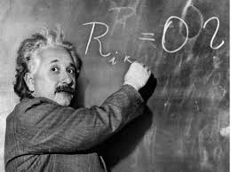
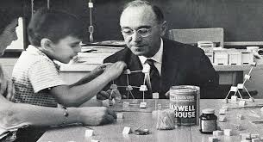
The value of questions
for Science and in School
"If I had an hour to solve a problem and my life depended on it, I would use the first 55 minutes to formulate the right question because as soon as I identified the right question I could solve the problem in less than five minutes." (Albert Einstein)
"The art of asking challenging questions is probably as important as the art of providing clear answers" (Jerome Bruner)
ABE site Italy/ Fontechiari M.A.
Notes:
https://issuu.com/chiarameow/docs/issuu_chiarafuca_stefanogioda
https://slideplayer.com/slide/8793540/
If I had an hour to solve a problem and my life depended on it, I would use the first 55 minutes to formulate the right question because as soon as I have identified the right question I can solve the problem in less than five minutes. (Albert Einstein)
The art of raising challenging questions is easily as important as the art of giving clear answers. (Jerome Bruner)

Slide 3
Questions in inquiry learning
involvement
evidence
explanations
communication
evaluation
Students are engaged with productive question (NRC, 2000)
IBSE
ABE site Italy/ Fontechiari M.A.

Slide 4
Productive questions
Scientifically related
Connected to the curriculum
- Investigable
ABE site Italy/ Fontechiari M.A.

Slide 5
INVESTIGABLE QUESTIONS
Questions "appropriate" for an investigation,
which can be answered through the analysis of data
ABE site Italy/ Fontechiari M.A.
Notes:
Which can be answered by doing something concrete with tools and materials, which naturally leads to taking action/making observations and measurements/using available tools and materials, gathering first-hand evidence with which to answer the question
Questions that can be answered by collecting observations and interpreting data
Questions that can be answered by simply asking someone for the answer, looking in a book or any source, that do not involve hands-on activities, that do not naturally lead to making observations, manipulating materials, using tools, making measurements, are not investigable
Virtual investigations, involving pc simulations, can be considered investigable

Slide 6
REQUIREMENTS for Investigable Questions
Are not notional (request for information) nor too complex and general (questions "Why..." )
Do not provide an unambiguous answer
Encourage reasoning
Are related to meaningful, real-world contexts
Are challenging
ABE site Italy/ Fontechiari M.A.
Notes:
Simple: What is the composition of the agarose gel? What type of measuring instrument is the micropipette , analog or digital?
Complex: Why do cells die?
Unambiguous answer: Does the genetic material of eukaryotes contain proteins? BETTER A MORE OPEN QUESTION: "What is the genetic material of eukaryotes made of?"
Ask questions that involve a plurality of alternative, equally plausible answers, that rather than requiring one specific right answer, require (inclusive) ideas and suggestions

Slide 7
What are the investigable questions?
What are the main types of rocks?
Why are enzymes essential for cells?
What happens if a reaction occurs in the presence of enzymes?
How does temperature affect the density of substances?
Is the cell membrane semi-permeable?
How do I know if the membrane is semipermeable?

Slide 8
EXAMPLES of investigable and non-investigable questions
5. "Is the cell membrane semi-permeable?"
5. "Is the cell membrane semi-permeable?"
4. "How does temperature affect the density of substances?"
4. "How does temperature affect the density of substances?"
6. "How do I know if the membrane is semipermeable?"
3. "What happens if a reaction occurs in the presence of enzymes?"
3. "What happens if a reaction occurs in the presence of enzymes?"
2 "Why are enzymes essential for cells?"
2 "Why are enzymes essential for cells?"
1 "What are the main types of rocks?"
1 "What are the main types of rocks?"
ABE site Italy/ Fontechiari M.A.

Slide 9
EXAMPLES of investigable and non-investigable questions
5. "Is the cell membrane semi-permeable?"
5. "Is the cell membrane semi-permeable?"
4. "How does temperature affect the density of substances?"
6."How do I know if the membrane is semipermeable?"
3. "What happens if a reaction occurs in the presence of enzymes?"
3. "What happens if a reaction occurs in the presence of enzymes?"
2 "Why are enzymes essential for cells?"
2 "Why are enzymes essential for cells?"
1 "What are the main types of rocks?"
1 "What are the main types of rocks?"
ABE site Italy/ Fontechiari M.A.

Slide 10
Transforming questions to make them investigable Variables scan (Jelly, 1985 )
ABE site Italy/ Fontechiari M.A.

Slide 11
TRANSFORM questions Variables scan (Jelly, 1985 )
Effective method for transforming "Why...?" questions.
Analyze the "non-investigable" question to
Identify variables related to the situation at hand
Formulate "What happens if...?" questions by changing a variable each time
More specific questions
that can be answered through an investigation
ABE site Italy/ Fontechiari M.A.

Slide 12
TRANSFORM questions Variables scan (Jelly, 1985 )
Effective method for transforming "Why...?" questions.
Analyze the "non-investigable" question to
Identify variables related to the situation at hand
Formulate "What happens if...?" questions by changing a variable each time
More specific questions
that can be answered through an investigation
ABE site Italy/ Fontechiari M.A.

Slide 13
TRAFORM questions Variables scan (Jelly, 1985 )
Effective method for transforming "Why...?" questions.
Analyze the "non-investigable" question to
Identify variables related to the situation under investigation
Formulate "What happens if...?" questions by changing a variable each time
More specific questions
that can be answered through an investigation
ABE site Italy/ Fontechiari M.A.

Slide 14
TRAFORM questions Variables scan (Jelly, 1985 )
Effective method for transforming "Why...?" questions.
Analyze the "non-investigable" question to
Identify variables related to the situation under investigation
Formulate "What happens if...?" questions referring to each
variable that can produce a change in the situation
More specific questions
that can be answered through an investigation
ABE site Italy/ Fontechiari M.A.

Slide 15
Modify questions Variables scan (Jelly, 1985 )
Why do plants grow?
ABE site Italy/ Fontechiari M.A.

Slide 16
Analyze the "non-investigable" question to identify variables related to the situation under investigation
↓
Formulate questions 'What happens if...? ' changing variable each time
↓
The answer to these specific questions is possible through an investigation
Why do plants grow?
VARIABLES:
Light Water
Soil Nutrients
What happens if the plants are in the dark?
What happens if I stop watering the plants?
What happens if you remove the plants from the soil and immerse them in water?
What happens if you put the plant in a sandy substrate?
What happens if you add nutrients to the soil?
ABE site Italy/ Fontechiari M.A.

Slide 17
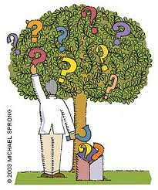
CRITERIA for productive applications
Availability of resources (materials and time)
Student Level
Related to topics that students are not familiar with
ABE site Italy/ Fontechiari M.A.
Notes:
Availability of time and materials: a question that can be addressed and resolved in the time available and with the materials present, i.e., it should not require the use of tools and materials that are not available, or require the application of very complex techniques/procedures
About Something Unknown: Questions should lead students to discover something that is unknown to them; this ensures authentic investigation, that is, what real scientists routinely do. Venturing into something unknown more easily captures students' attention and creates passion the focus of learning.

Slide 18
CHECK LIST for productive applications
Is it investigable?
Is it interesting, challenging, stimulating for students?
Is it adequate in terms of difficulty, time, and materials?
Is the answer unknown to students?
ABE site Italy/ Fontechiari M.A.
Notes:
Availability of time and materials: a question that can be addressed and resolved in the time available and with the materials present, i.e., it should not require the use of tools and materials that are not available, or require the application of very complex techniques/procedures
About Something Unknown: Questions should lead students to discover something that is unknown to them; this ensures authentic investigation, that is, what real scientists routinely do. Venturing into something unknown more easily captures students' attention and creates passion the focus of learning.

Slide 19
Productive Questions
Who is proposing the productive question?
If it is proposed by the teacher, how to introduce it?
How to make it meaningful for students?
How to highlight its relevance?
ABE site Italy/ Fontechiari M.A.

Slide 20
INTRODUCING productive questions
- files
- video
- pictures
- direct observation of facts and phenomena
exploration of materials
discrepant events
field trips
experimental demonstrations
ABE site Italy/ Fontechiari M.A.

Slide 21
Productive Questions
Who proposes the investigable question?
If it is proposed by the teacher, how to introduce it?
How to make it meaningful for students?
How to highlight its relevance?
ABE site Italy/ Fontechiari M.A.

Slide 22
Relevance to investigable questions
Require students to note the question
Write the question on a poster board to display in the classroom
Recall the question at the beginning and during activities
ABE site Italy/ Fontechiari M.A.
Notes:
Pre-knowledge: help connect what you know with what you want to discover

Slide 23
Productive Questions
Who proposes the investigable question?
If it is proposed by the teacher, how to introduce it?
How to make it meaningful for students?
How to highlight its relevance?
How to stimulate students to formulate investigable questions?
ABE site Italy/ Fontechiari M.A.

Slide 24
STUDENTS and investigable questions
Mostly uninvestigable questions
Unfocused questions
- General difficulty and low propensity
ABE site Italy/ Fontechiari M.A.

Slide 25
STIMULATE investigable questions
Show examples
Propose dedicated activities
Allow time to think and reflect and provide for individual, pair and group activities
Avoid making judgments
Bringing out pre-knowledge
ABE site Italy/ Fontechiari M.A.
Notes:
Pre-knowledge: help connect what you know with what you want to discover
Awareness of what we know helps clarify what we don't know and what we want to discover KWL Tables

Slide 26
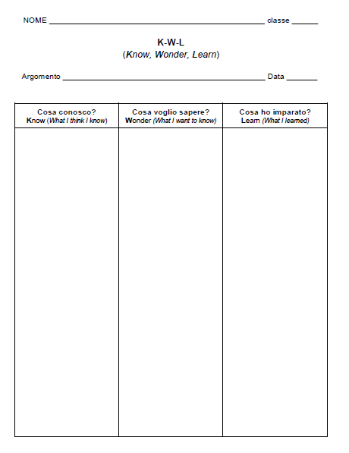
KWL (Know, Wonder, Learn) TABLES
ABE site Italy/ Fontechiari M.A.

Slide 27
CHECK LIST for productive questions
Am I interested in answering this question?
Do I already know the answer to this question?
Does the question clarify what I need to do (observe, measure, ...) to answer?
Am I able to get the materials I need to answer the question?
Does the time I have available coincide with the time I actually need to answer the question?
ABE site Italy/ Fontechiari M.A.
Notes:
Good investigable questions are interesting
Good investigable questions are those for which the answers are not already known
Good investigable questions are those that lead to drafting an action plan to plan actions (a plan of what I need to do to answer the question, which includes the evidence to be gathered)
Good investigable questions are those that can be answered through the available materials
Good investigable questions are those that can be answered within a reasonable amount of time

Slide 28
Thank you for your attention!

