Slide 1
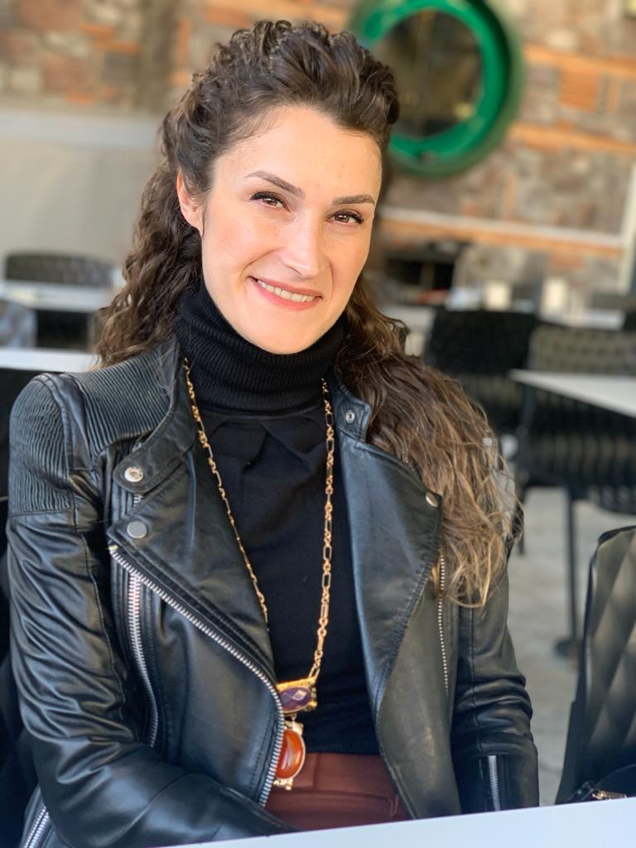
Dr. Ayşegül Tanrıverdi
Biology Teacher
Gazi Vocational and Technical Anatolian High School
ABE Teacher Roundtable

Slide 2
4 Types of Collaboration in ABE Implementations
Connecting two apps with scenario
Collaboration with a vocational school teacher who is not an ABE teacher
Moving ABE to e-Twinning platform
Sharing classroom experiences with new ABE teachers

Slide 3
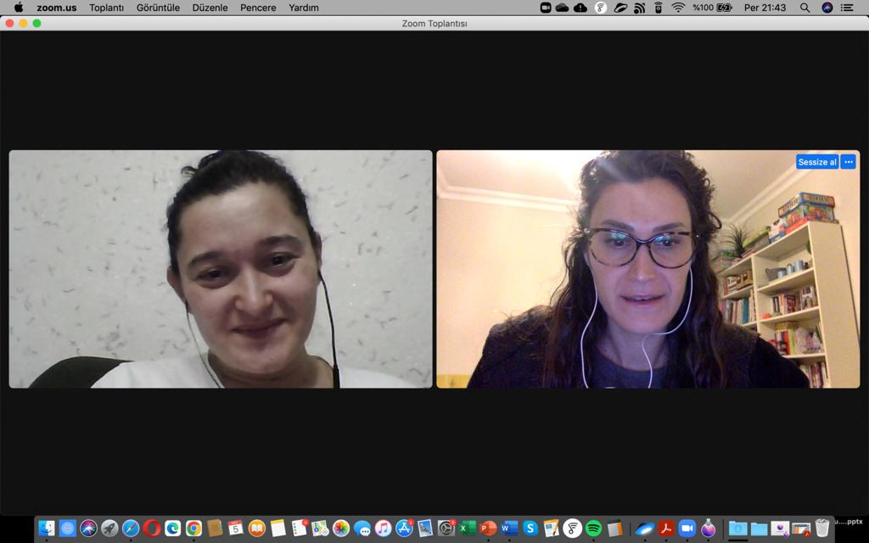
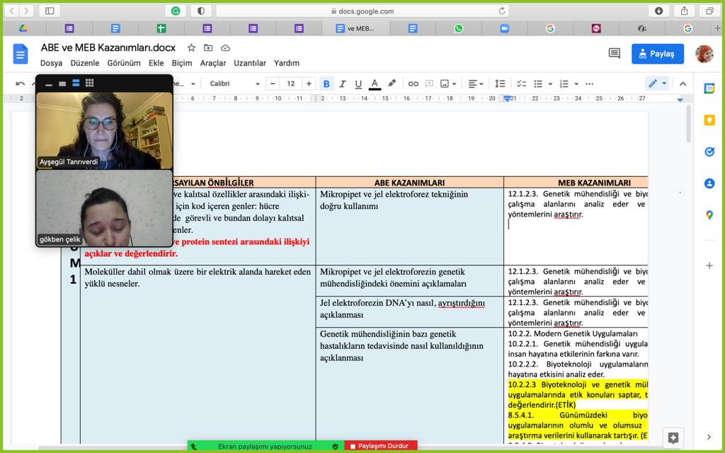
1. Classification of biotechnology applications and DNA isolation during the pandemic period

Slide 4
Discussion Questions in the First Lesson:
What are biotechnology applications?
What are the application examples?
How would you group biotechnology applications if we were to group them?

Slide 5
Inertia in the Pandemic

Slide 6
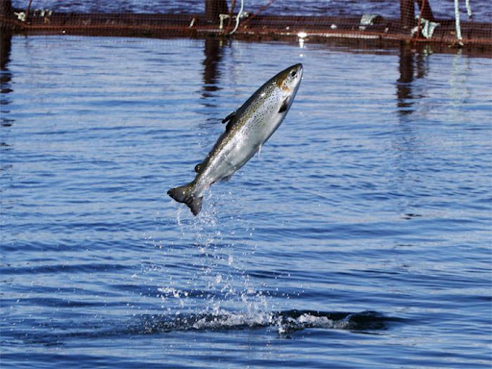
SCENARIO:
You are a scientist at the genetic research institute within the Ministry of Agriculture and Livestock in Norway. In a file you have received, as a result of public surveys, it is determined that one of the favorite smells of the Norwegian people is the smell of banana, and it is recommended that this determination can be used to increase fish consumption. Upon this recommendation, you are asked to transfer the smell of banana to the fish. How can you do this work?

Slide 7
Discussion Questions:
1. Which part of the banana needs to be transferred in order to transfer this feature? How much of it should be transferred? Should it be transferred all or part of it?
2. Is the DNA you obtained pure? If yes, justify your explanation. If no, what other materials are present in the sample you isolated? What steps do you need to follow to further purify your sample?
3. Did you isolate DNA from a single cell? Why?
4. Why do you think you couldn’t isolate DNA?
5. Is the DNA isolation process the same in all living things? Why?

Slide 8
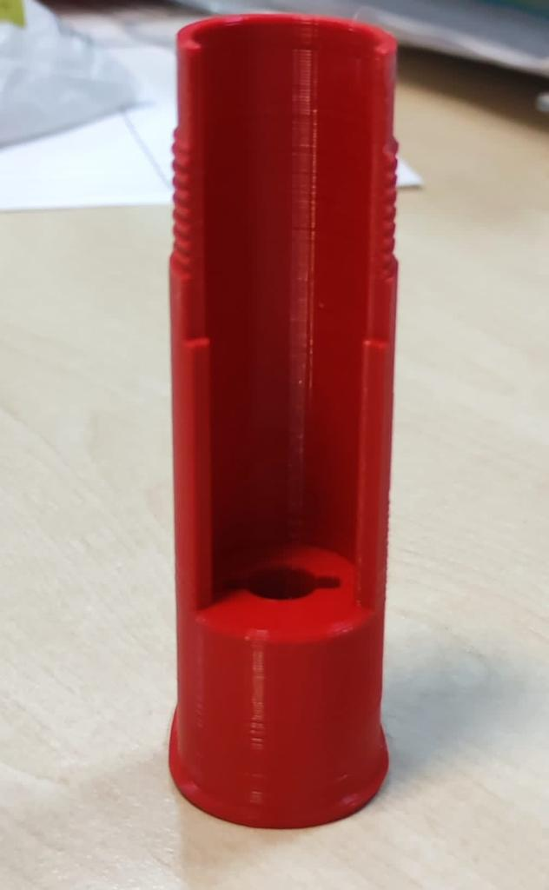
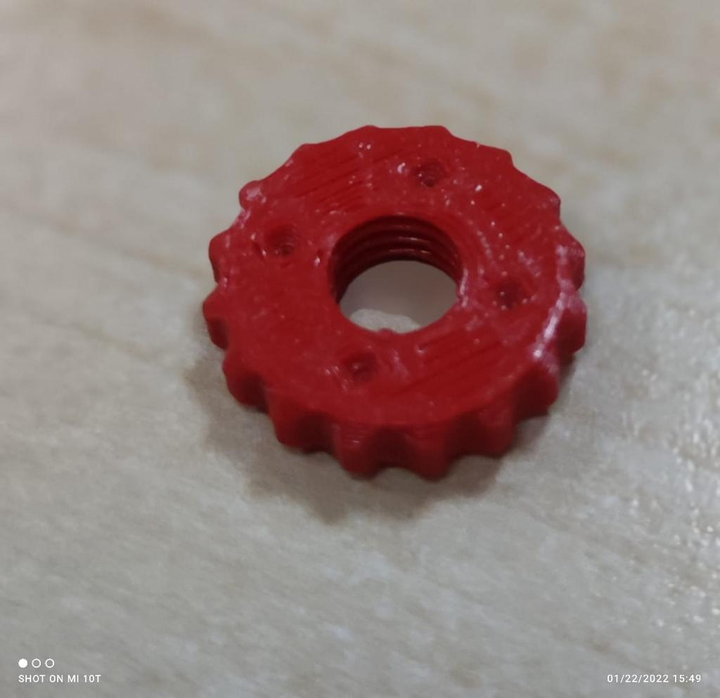
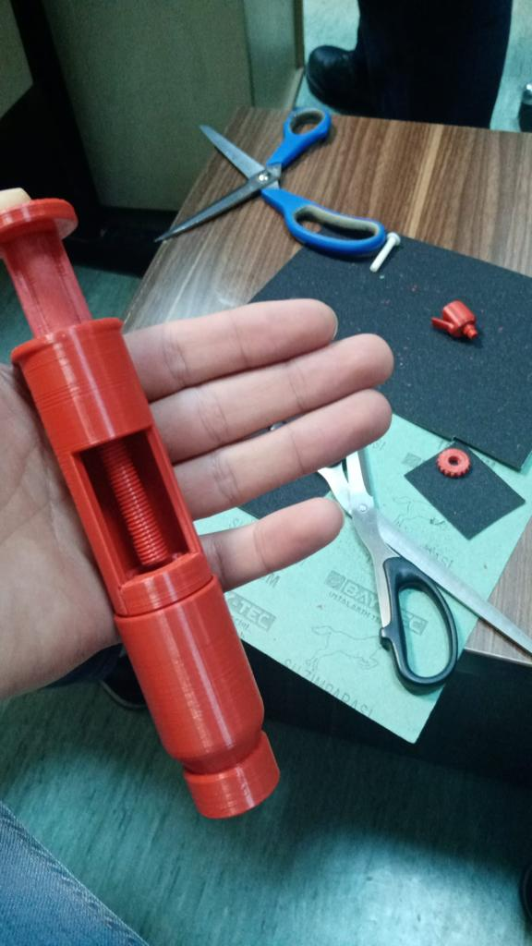
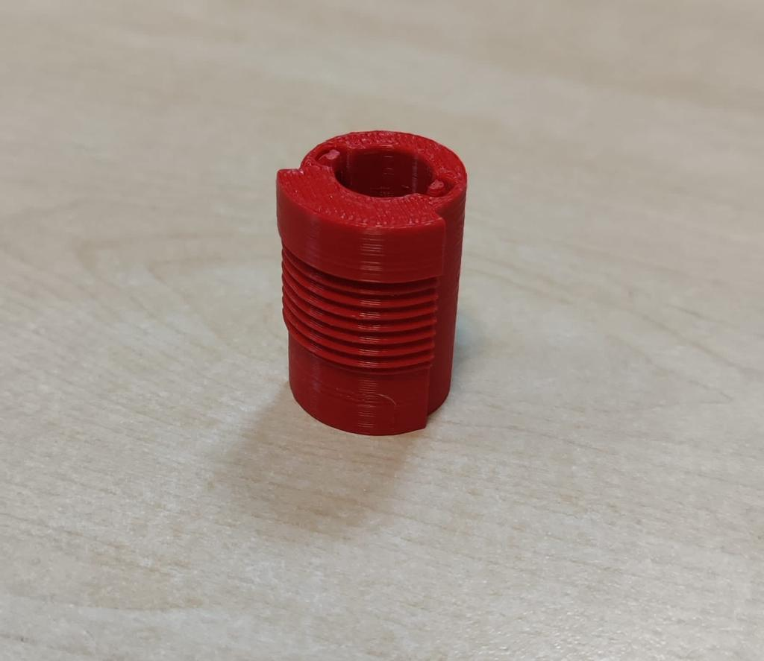
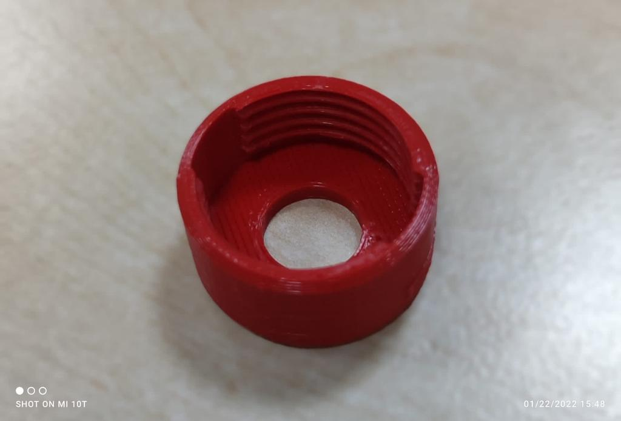
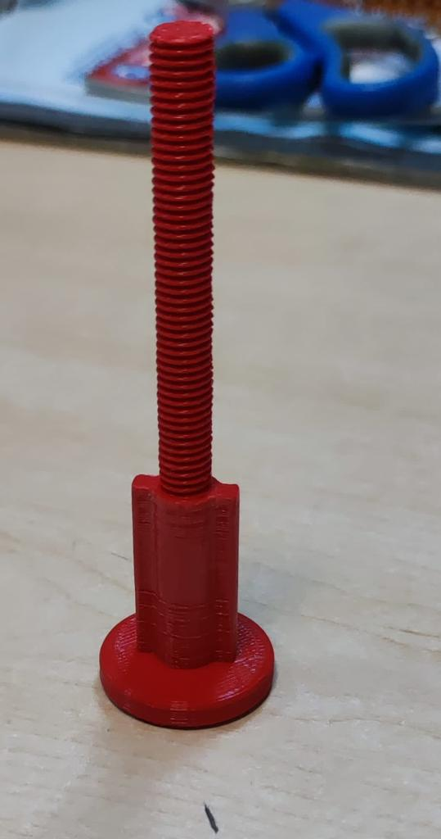
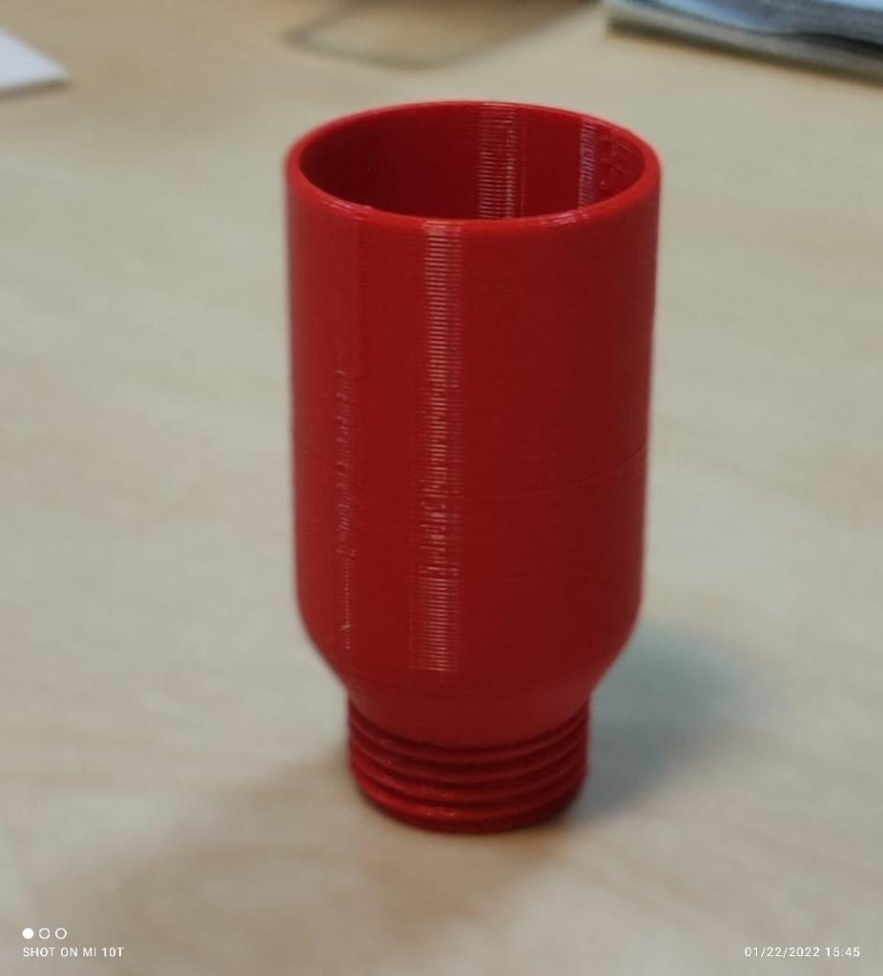
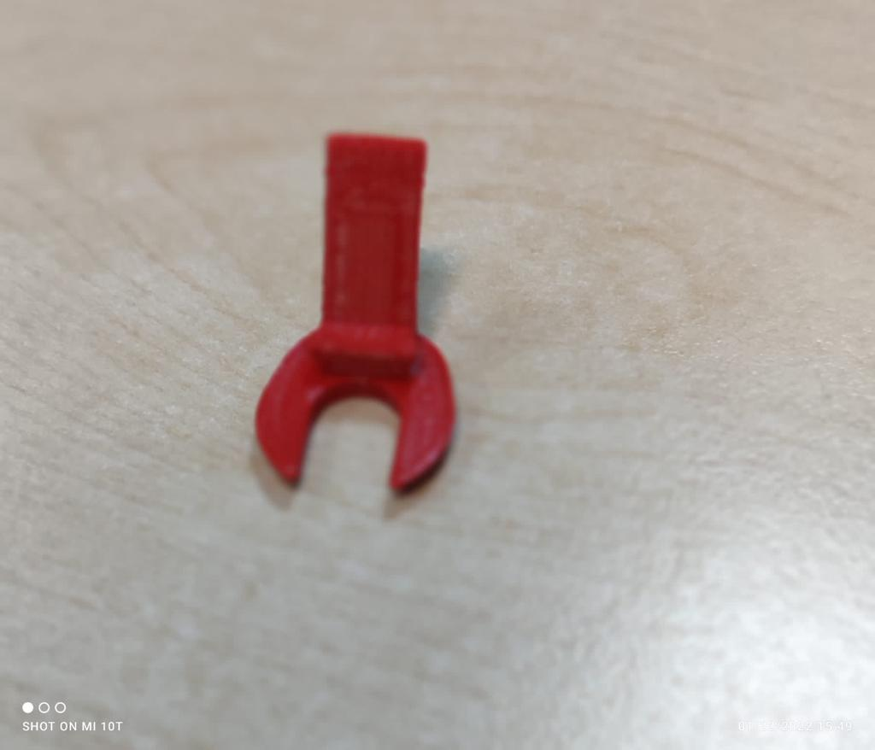
2. Collaboration with a colleague who is not an ABE teacher
Designing a micropipette

Slide 9
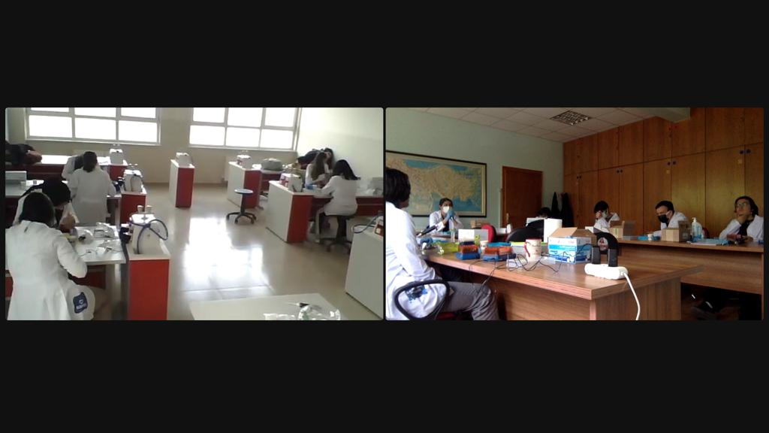
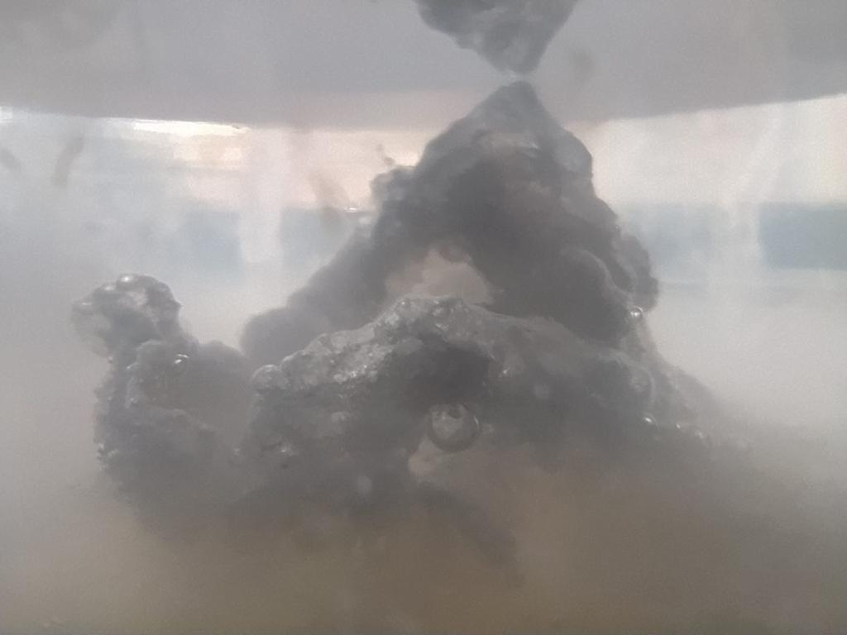
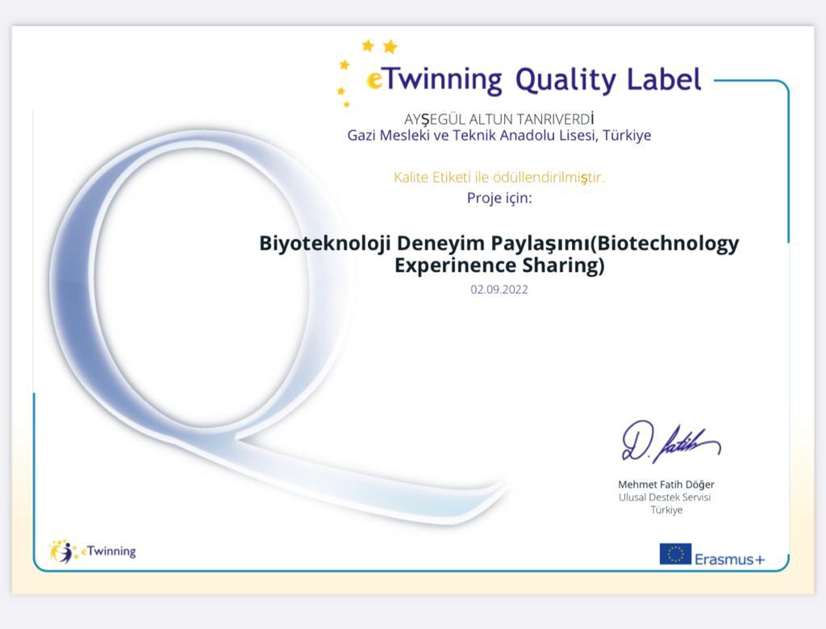
3. We moved ABE to e-Twinning Platform
Isolated DNA

Slide 10
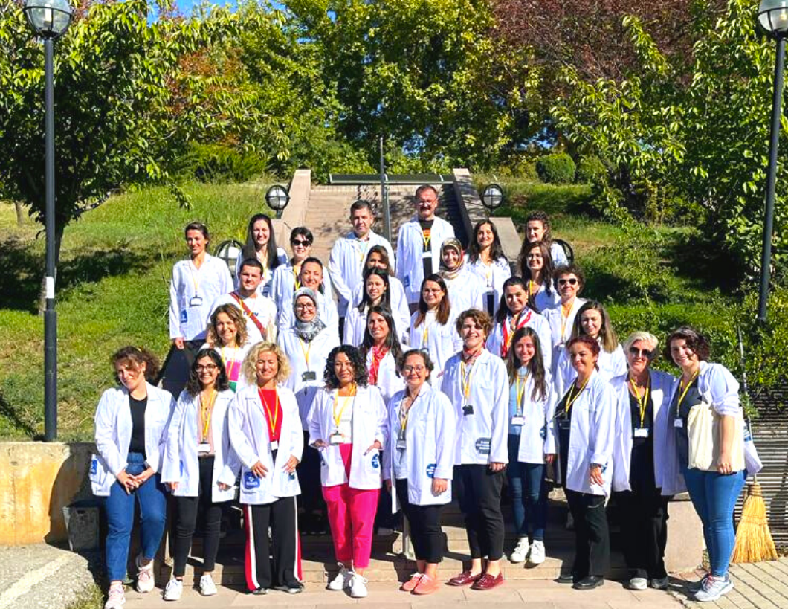
4. The New Teachers of the ABE Community.

