Slide 1
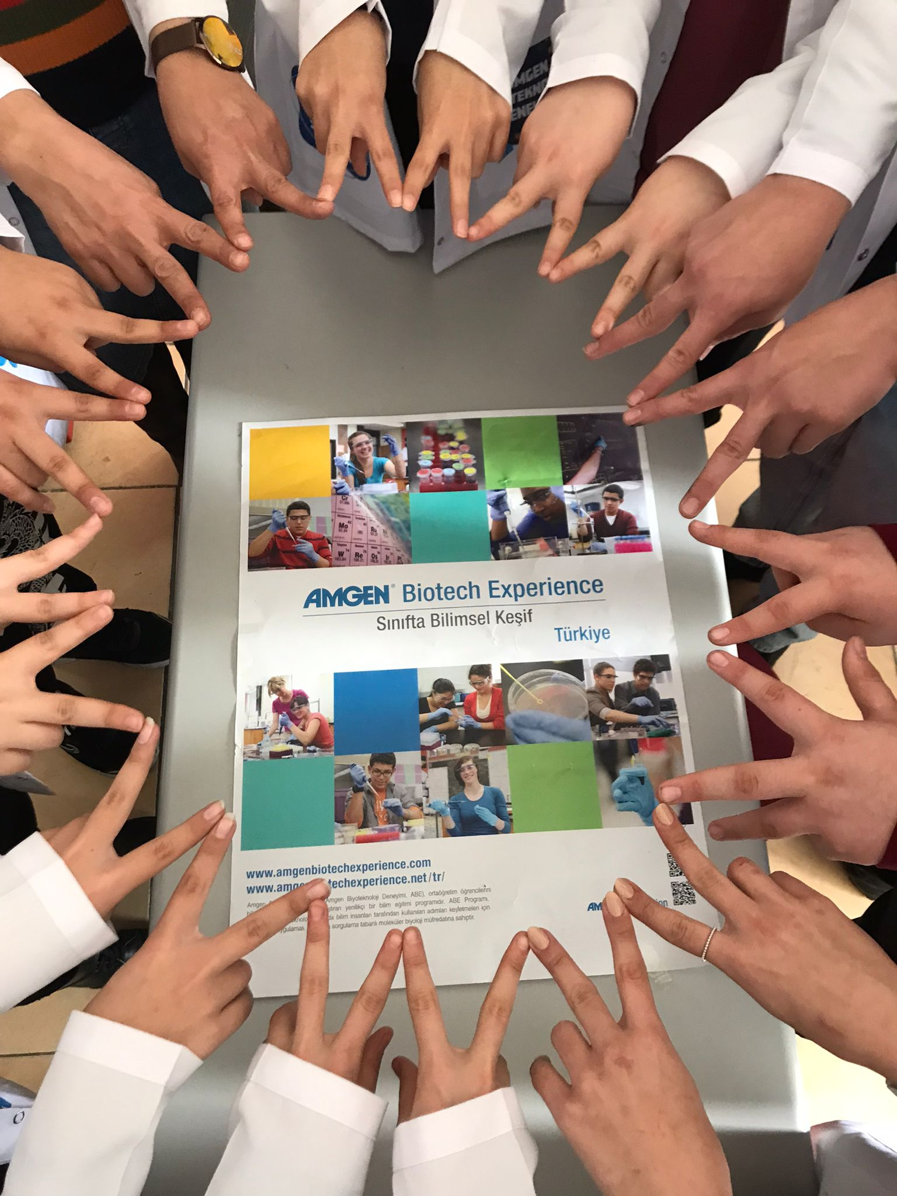
ABE Teacher Roundtable

Slide 2
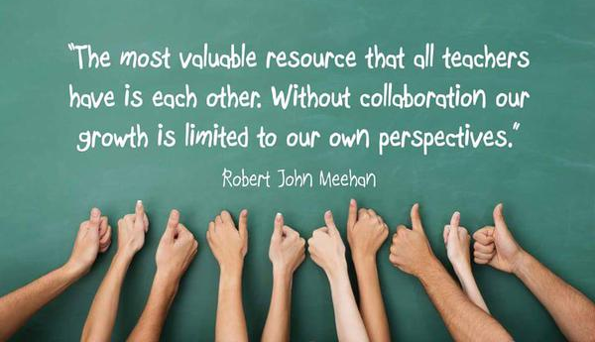

Slide 3
Why & When do teachers needs to collaborate with each other?
Sharing their good practices
Coping with their difficulties
Sharing their responsibilities to Improve their classroom practices

Slide 4
Teacher Change Model and
Teacher Collaboration
Guskey (2002)

Slide 5
Benefits of Teacher Collaboration
Professional Growth
Improved Student Outcomes
Improved Teacher Practice

Slide 6
Peer Collaboration:
Professional Growth
It provides emotional support.
It allows teachers to feel a sense of belonging.
It increases teacher efficacy.
It allows teachers to play to their strengths and learn from one another.

Slide 7
Peer Collaboration:
Improved Teacher Practice
It increases pedagogical knowledge
Implementing different questioning strategies
Implementing different measurement and assessment strategies
Integrating different innovative teaching strategies (e.g., inquiry-based science education, argumentation, outdoor learning, STEM, design thinking activities, interdisciplinary teaching, project-based teaching, etc.)
Implementing classroom management strategies
Focusing objectives from different domains in their implementations
It increases content knowledge
Increased biology, chemistry, physics, biotechnology knowledge, etc. and opportunity to integrate different content knowledge
It increases technological knowledge
Using different Web 2.0 teaching tools (Padlet, Mentimeter, Kahoot!, Canva, etc.)
Integration of online learning platforms (LabXchange, Khan Academy, etc.)

Slide 8
Peer Collaboration:
Student Outcomes
Less student behavioral problems
More student participation from different backgrounds
More meaningful, concrete and permanent learning
awareness of biotechnology career
content knowledge in different disciplines
a variety of students’ skills such as laboratory skills, collaboration skills, 21st century skills, design thinking skills, ethical reasoning skills

Slide 9
Challenges and Advices
Community of Practice (Jean Lave and Etienne Wenger): groups of people who share a concern or a passion for something they do and learn how to do it better as they interact regularly.
Developing a community of practice
Nurturing the community of practice

Slide 10
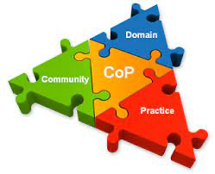
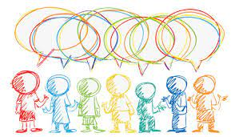
Challenges and Advices
What
we care about
Community of Practice (Jean Lave and Etienne Wenger): groups of people who share a concern or a passion for something they do and learn how to do it better as they interact regularly. All of these legs change over time. The trick is not to have all three changing at the same time.
Developing a community of practice
Nurturing the community of practice
How
we function
What
we have learned

Slide 11
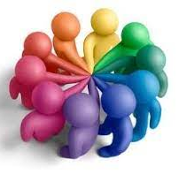
Challenges and Advices:
Developing a Community of Practice
Finding a common purpose, concern, or passion to work together (different types of community of practice based upon the common purpose)
Helping Communities: help each other with everyday work needs
Best Practice Communities: develop and disseminate best practices, guidelines, and strategies for their members’ use
Knowledge Stewarding Communities: organize, manage, and steward a body of knowledge from which community members can draw
Innovation Communities: create breakthrough ideas, new knowledge, and new practices
elif@ka.org.tr

Slide 12
Challenges and Advices:
Developing a Community of Practice
Determination of the community rules
Selection of internal leaders for different purposes (a leader to organize the meetings, a leader to collect and organize the information, a leader to connect the community with other communities, a leader to look “out of the box”, a leader to maintain positive interpersonal relationships, etc.)
Identification of a regular but flexible meeting times
Selection process of new group members

Slide 13
Challenges and Advices:
Nurturing a Community of Practice
Recognizing the work done by each member of the community through intrinsically self-sustaining reward systems (creating opportunities to talk about how their participation contributes to the community, creating an environment in which the value they bring is acknowledged)
Connecting to the real practices, leverage the potential that already exists
Providing support through encouraging them to move forward and remain focused on the common purpose as well as to identify and eliminate barriers to participation

Slide 14
Thank you!

