Slide 1
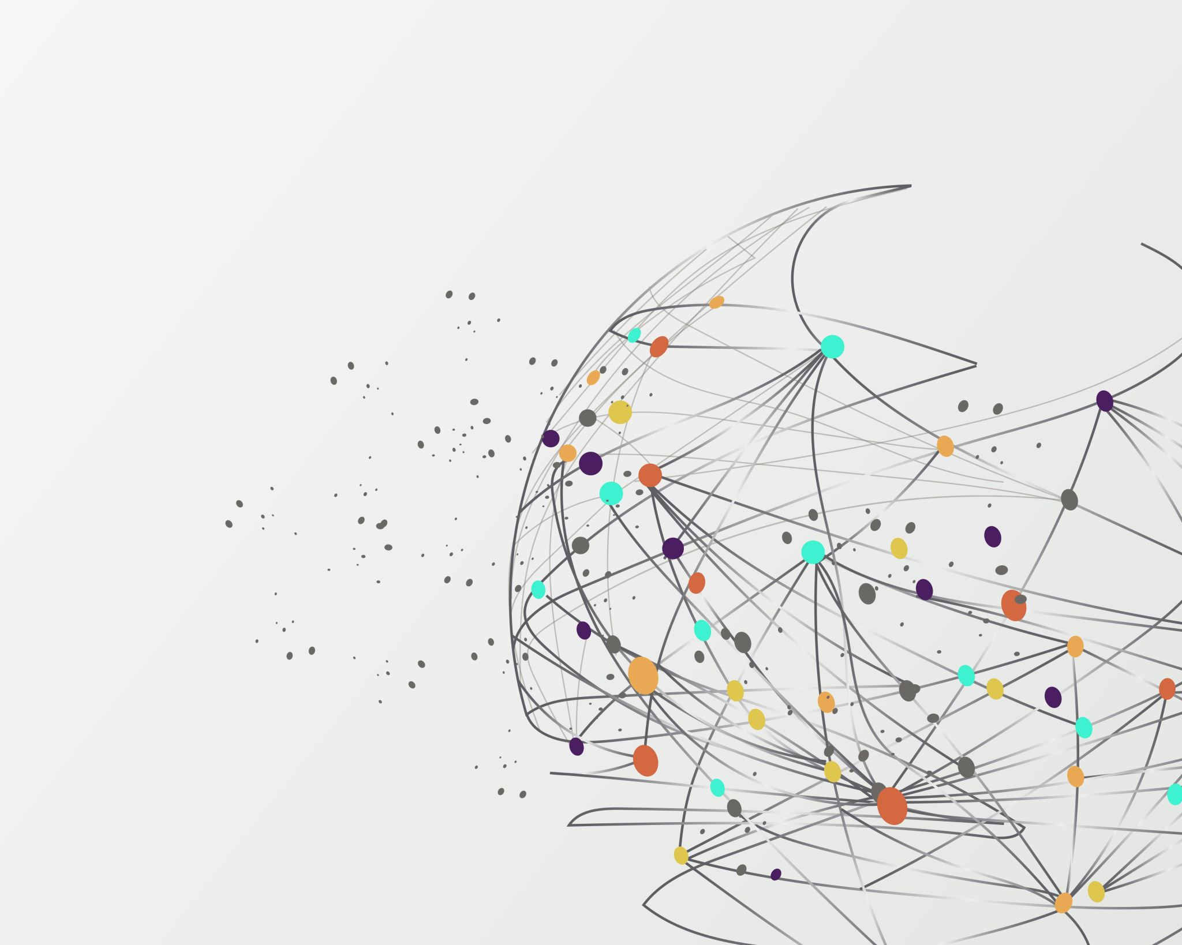
Career Connections via High School Laboratories
Laurie Jackson-Grusby, PhD
Brockton High School
Brockton, MA

Slide 2
3 Strategies
Curriculum Connections
Capstone Course
After School Enrichment Course

Slide 3
Curriculum Connections
ABE (naturally!)
Project-based learning
Field trips
Scientist visitors

Slide 4
Capstone Course
Citizen Science
Original Research
Content and Lab Skills Learning
Connection with Tufts Infectious Disease

Slide 5
After School Enrichment
Funded Apprenticeships
Foster independence and collaboration
Content and Lab Skills Learning
Connection with Internship Partners
(Dana Farber, Forsyth, Ragon)

