Slide 1
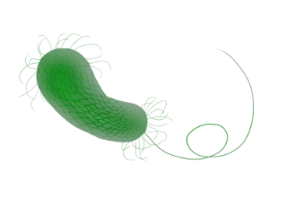
Promoting Lower Secondary Biotech Engagement Through ABE
Marlene Barrientos
John F. Deering Middle School

Slide 2
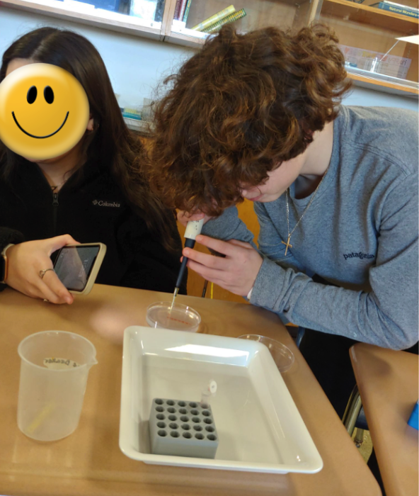
How we connected students to career opportunities and skills
1
ABE- Volunteer program: guest speakers from AMGEN share their pathway to a science career and provide an overview of their work
2
ABE- secondary pilot program
With the loaned equipment and reagents-able to turn my classroom into an advanced science class and provide real-world lab experience
“8th graders can benefit from this, as they'll almost be in 9th grade and being able to choose what classes they want to do. Introducing this to them helps them come to the decision.” “.. it was fun and I felt like I learned something that is useful.” Former ABE Student

Slide 3
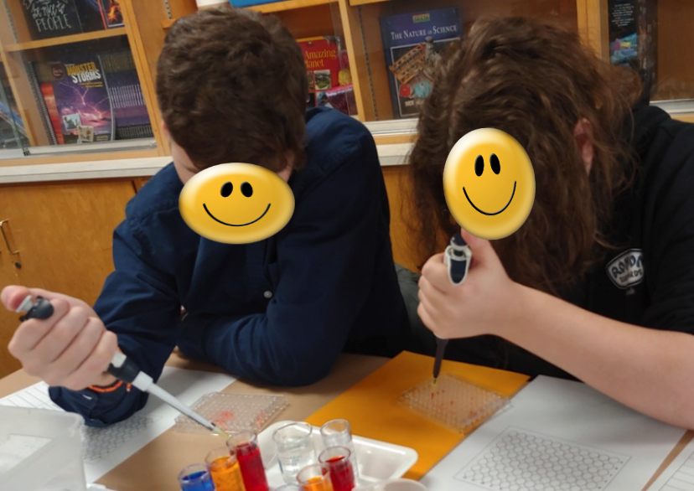
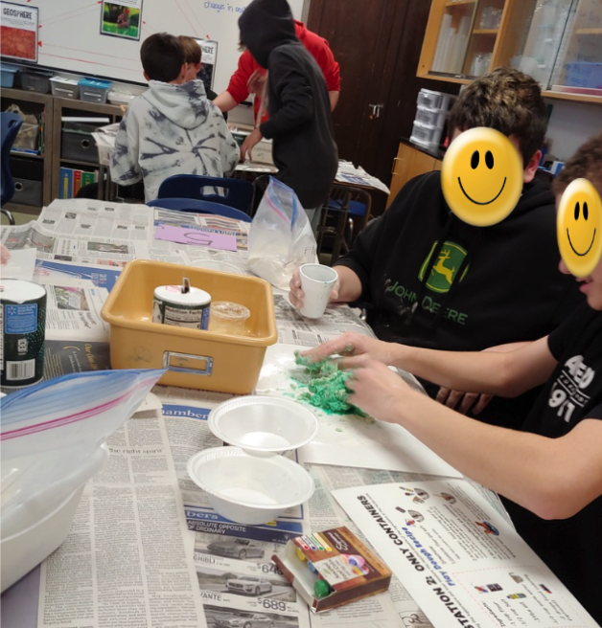
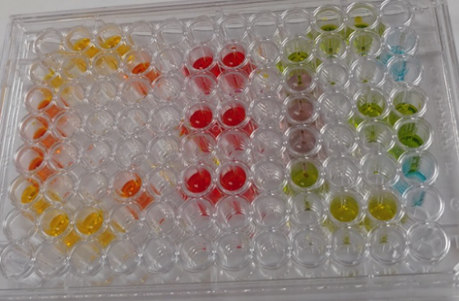
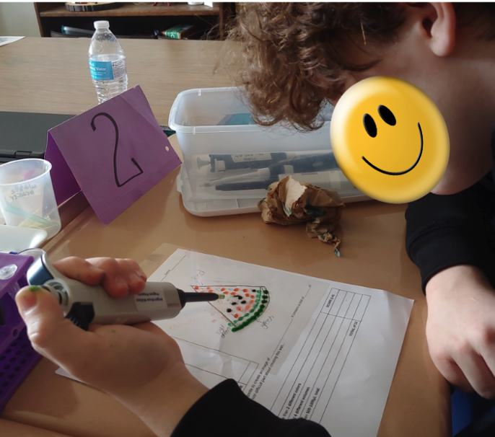
Introducing Biotechnology to Younger Students
Requires simplifying complex concepts, making it relevant, engaging and fun.
PBL mystery: Tracking Fecal matter in water samples
Use videos and slideshows with- great visuals
Differentiate the activities
Notes:
Use connections to everyday aspects of their lives helps students better understand biotechnology and creates interest
Visuals can greatly enhance the effectiveness of teaching biotechnology to kids, make complex concepts easier and engaging
Same learning goal but same activity was differentiated based on the s’ learning needs
Moving slower
Reassuring the students that they are in a safe learning environment. The content, the equipment is above them that they have not experienced before. Feeling safe to know that it is OK to make mistakes that I am there to support them in developing the content knowledge and skills. Some students required a more direct guid

Slide 4
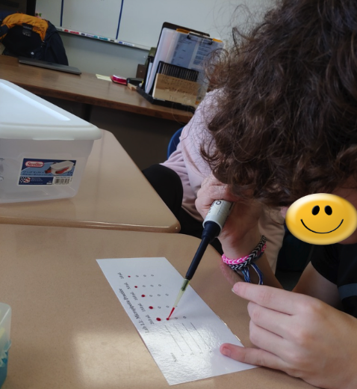
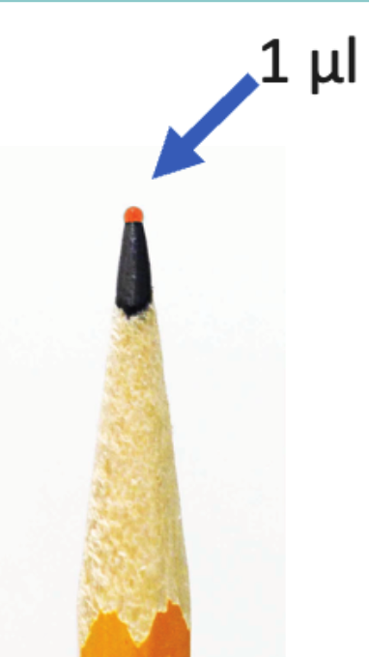
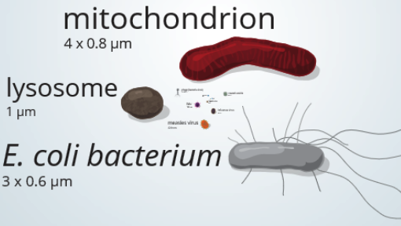
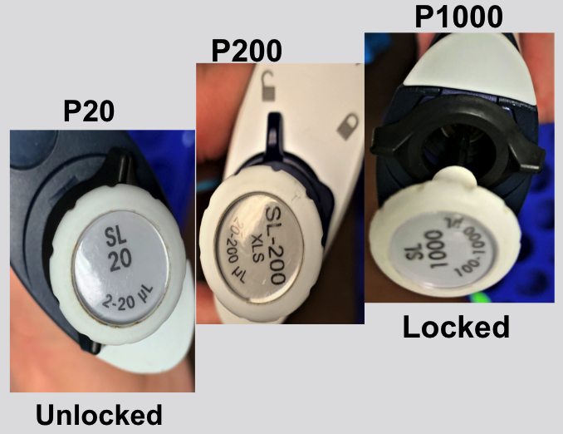
Process
Introduce proper use of the micropipette
Practice Pipetting
Introduce microliters
1
Parts of a micropipette
3 sizes of micropipettes
Setting the volume
Micropipette tips
Pipetting Rules
3
https://learn.genetics.utah.edu/content/cells/scale/
2
Practice setting volume and locating the two stops & eject button
Practice on a laminated sheet and doing Pipette art
Notes:
2. Parts of a micropipette: practice being able to recognize first and second stop
- So the students can easily recognize and feel comfortable using the proper micropipette I use masking tape to label each with
P20, P200 & P1000
3. Increase & decrease volumes, common mistakes

Slide 5
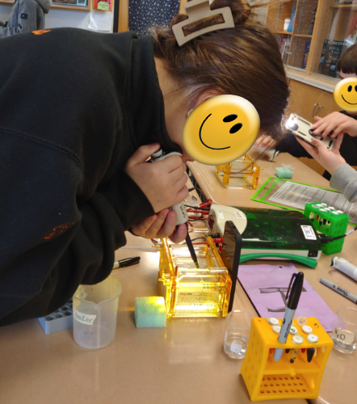
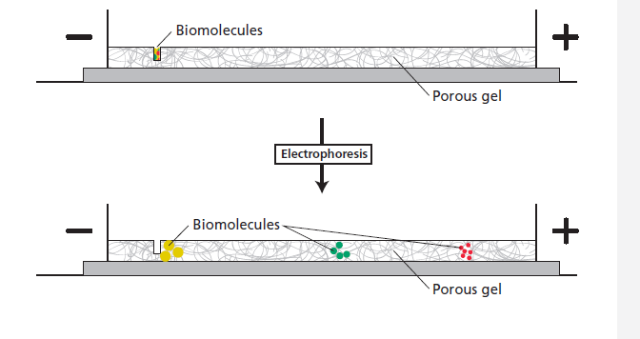
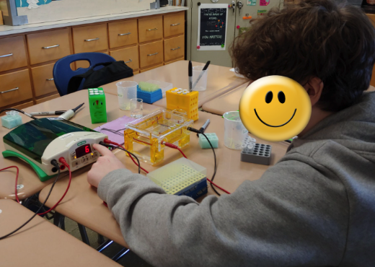
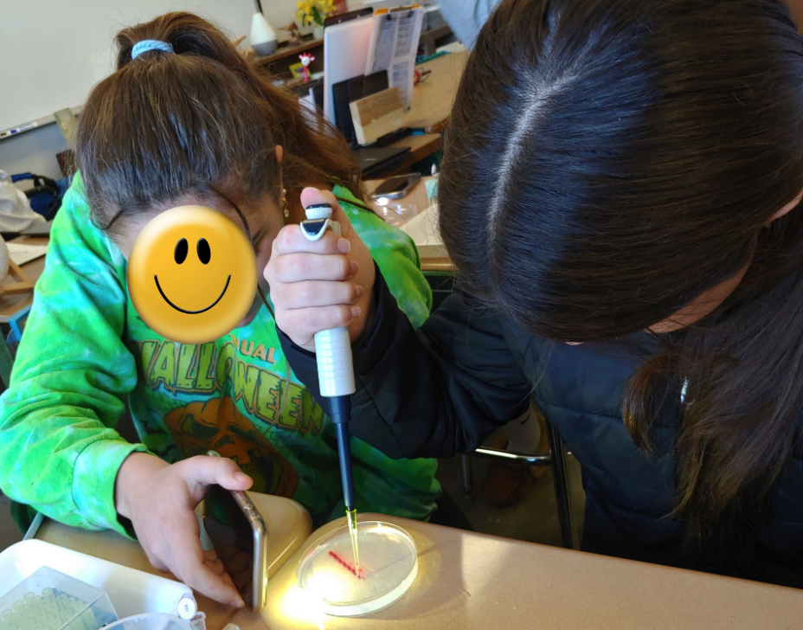
Process, continued
Gel Pipetting Practice
Introduce gel electrophoresis
Run Gel Electrophoresis
More advanced students made the buffer
(C₁ V₁ =C₂V₂) and gels
Practice loading wells in practice plates (model first)
4
6
Review DNA structure
Become familiar with gel electrophoresis- virtual simulations 2
Play Blooket
A day before model-proper loading
Teach how to use the centrifuge
5
Notes:
4. Look at the name to remember the requirements: gel and electricity. how electrophoresis facilitates the separation of molecules, Know the conditions and supplies necessary to visualize and interpret a gel, importance of using buffer & the purpose of the loading dye
5. Ask if they ever made OJ from a concentrate- 1 cup of concentrated to 3 cups of water. OJ from a concentrate is a Dilution.

Slide 6
Thank you.

Slide 7
Learning Goal
To learn how to accurately measure and transfer very small amounts of volume (microliter,µL, amounts) using micropipette.
Explain the importance of micropipettes in biotechnology
Notes:
As with all fine motor skills, learning
how to use a micropipet takes practice and determination. You must be
able to measure these tiny volumes with accuracy.

Slide 8
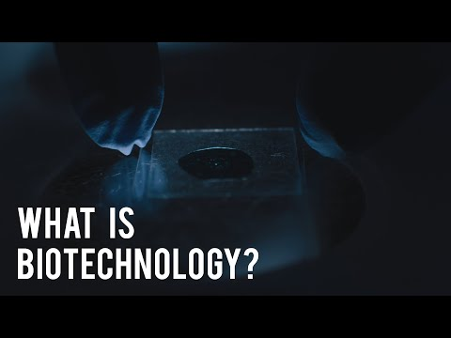
What is Biotechnology?
Biotechnology= Biology + Technology
Use of living systems or organism or derivatives to develop or modify products, or technological applications
C
G
A
T
Notes:
https://www.youtube.com/watch?v=yLkU_Sp_PYU
https://www.youtube.com/watch?v=f8PyAQ9bAPk&t=83s

Slide 9
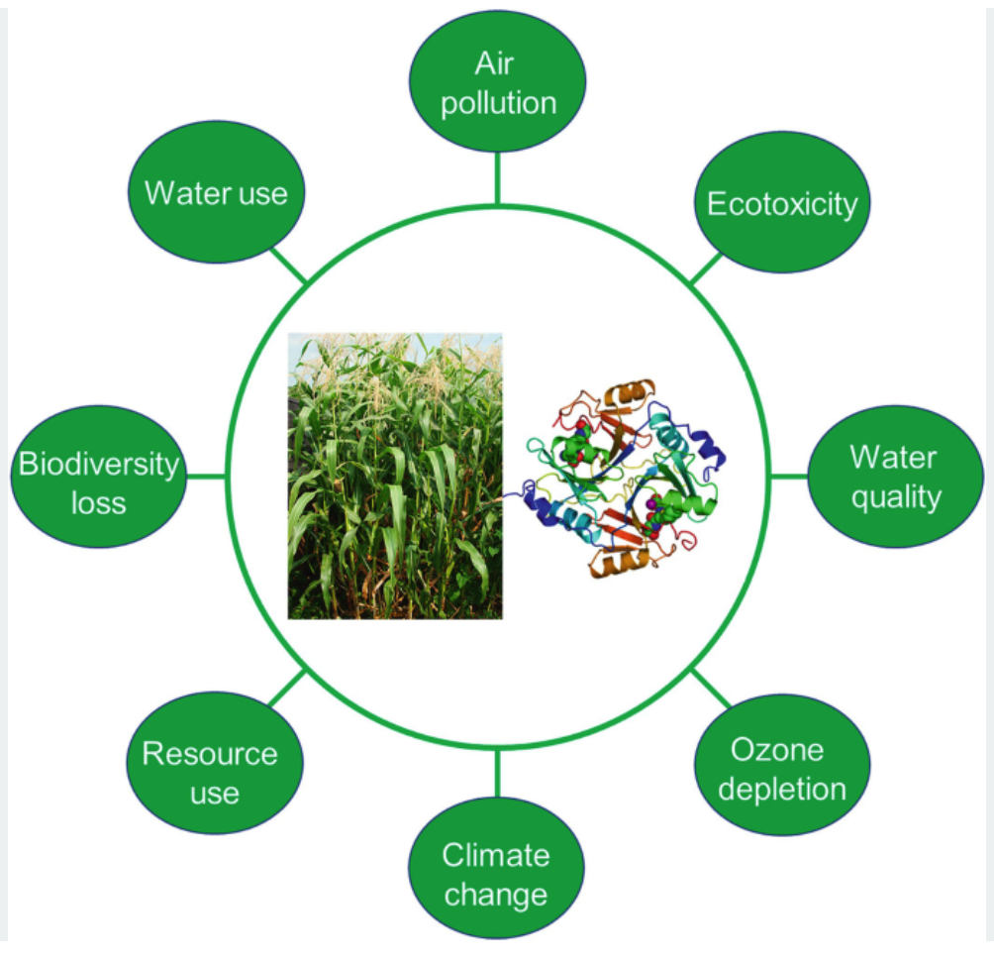

Environmental Biotechnology
How do we deal with the pollution we have these days?
The tools and techniques we’ll learn in the next few days are fundamental to the biotechnology industry.
Go Back
Notes:
Tracking fecal matter in samples of water- E. Coli

Slide 10
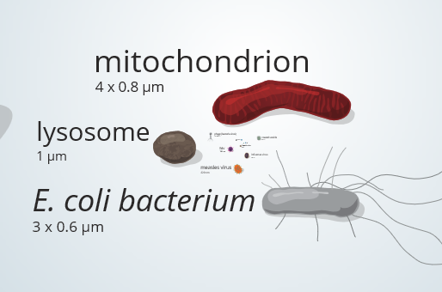
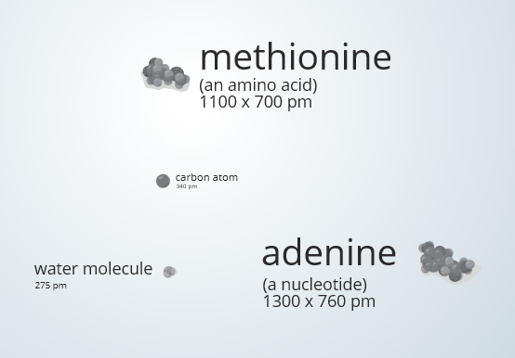
Measure for Measure
Go to this website.
http://learn.genetics.utah.edu/content/cells/scale/
As a class, stop at the objects in the μm range. Those look small.
The dye molecules that will be using in the lab would be in the pm range.
The materials dissolved in the volumes, such as the dyes we use, are still a million times smaller. 100 μl volume is like a swimming pool-sized volume compared to dyes, proteins, viruses, DNA
Notes:
Drop of water ~ .05 ml x 1,000,000 / 1000 = 50 L ~

Slide 11
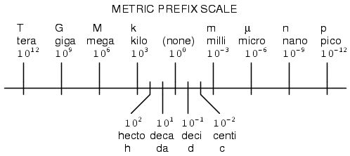
Microliters are part of the Metric System
g, L, m
K
H
Da
B
d
c
m
µ (micro)
King
Henry
drinking
Chocolate
milk
Died
By
(So stop) making it

Slide 12
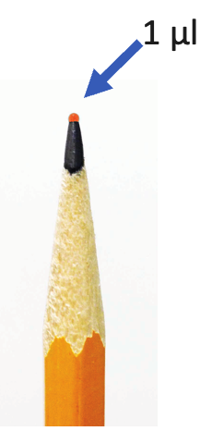
Working with Extremely
Small Quantities
Labs that work with enzymes, DNA and buffers need to precisely measured and transferred them to microtubes that serve as reaction vessels.
These reactions are often done in microliter volumes
To make these precise measurements, scientists use a precision tool known as the micropipette
Go back

Slide 13
Intro to Micropipettes
Notes:
https://libguides.fredhutch.org/SEP/Micropipetting

Slide 14
Prior to lab you should understand:
Basic parts of micropipette
What volumes are measure with P20, P200 and P1000 micropipettes
How to read volume indicator on a P20, P200, and P1000

Slide 15
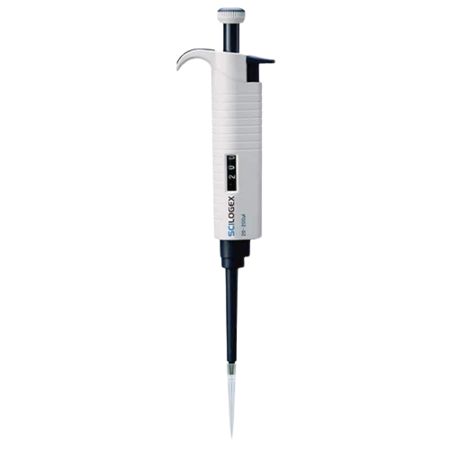
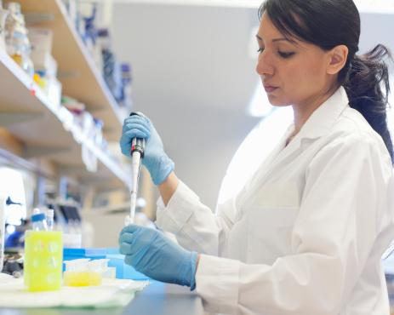
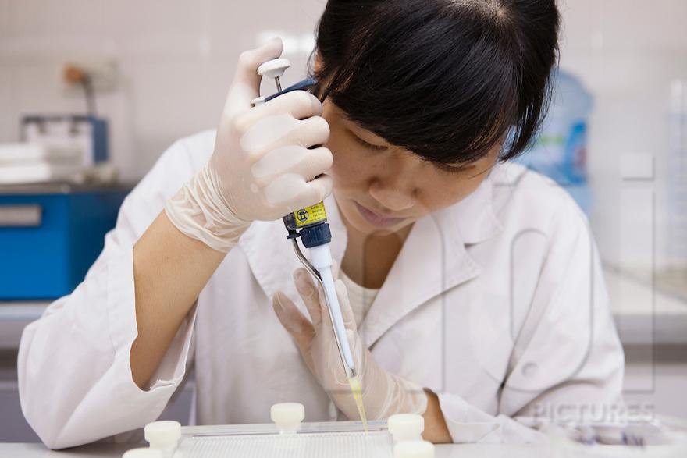
Micropipettes
Micropipettes are important tools used in research labs to accurately measure small quantities of liquid
Delicate
Very expensive
Crucial to working with DNA
Notes:
Do we have pictures of students?

Slide 16

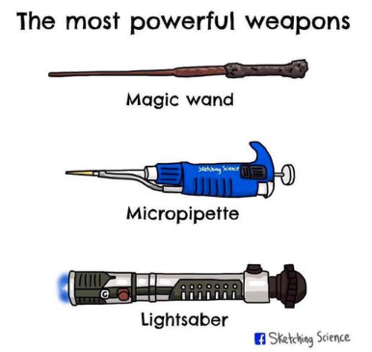
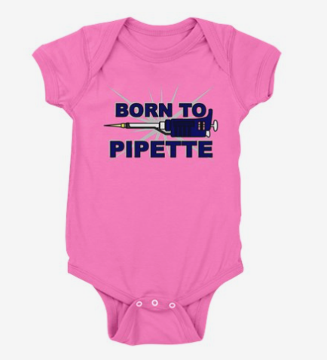
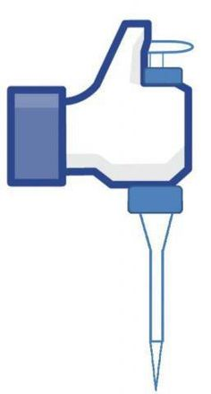
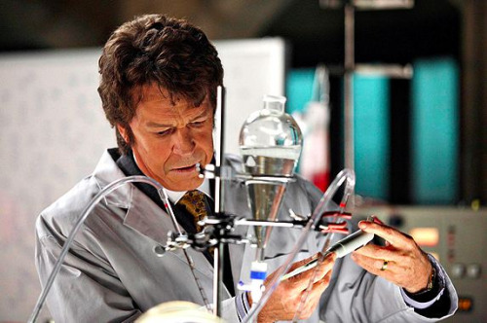
Micropipettes are important enough to have found a place in popular culture, including a tumblr page dedicated to pictures of Hollywood getting it wrong:
“That’s not how you pipette”
http://thatsnothowyoupipette.tumblr.com/

Slide 17
Parts of a Micropipette
Plunger
Volume adjuster
Tip ejector
Attachment for
disposable tip
Digital volume indicator

Slide 18
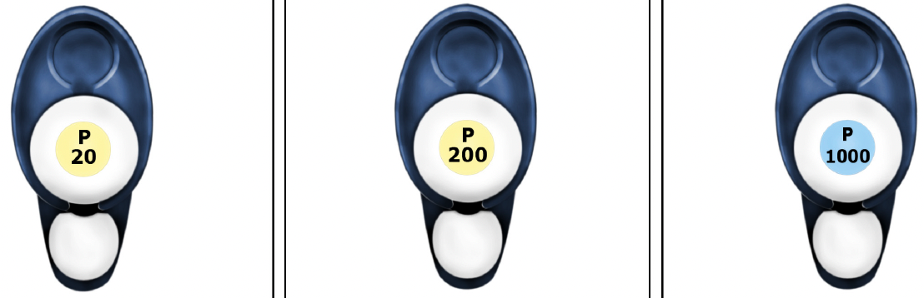
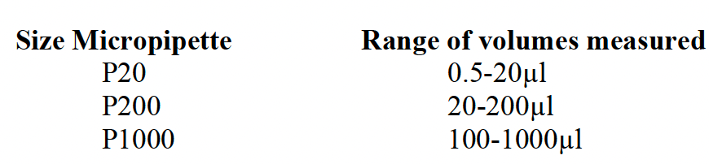
Three sizes of micropipettes

Slide 19
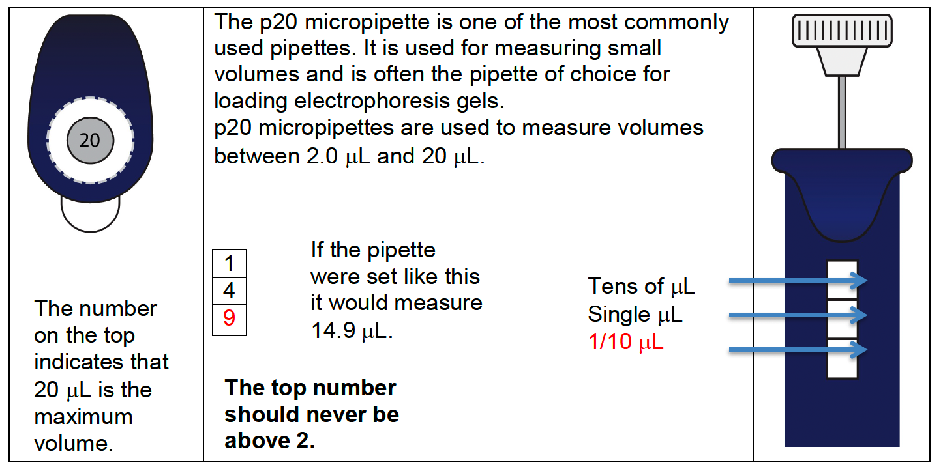
P20: Setting The Volume
Used to measure volumes between 2.0 µL and 20 µL

Slide 20
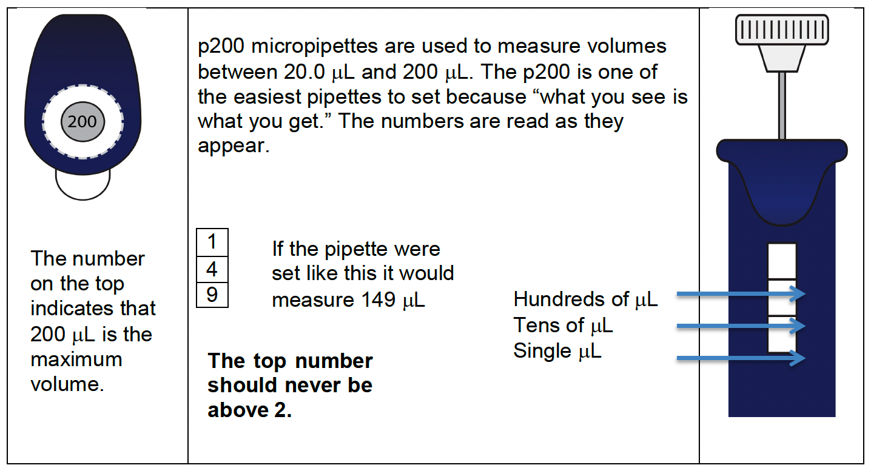
P200: Reading The Volume
Easiest pipettes to set because “what you see is what you get.”
The numbers are read as they appear
Used to measure volumes between 20.0 µL and 200 µL

Slide 21
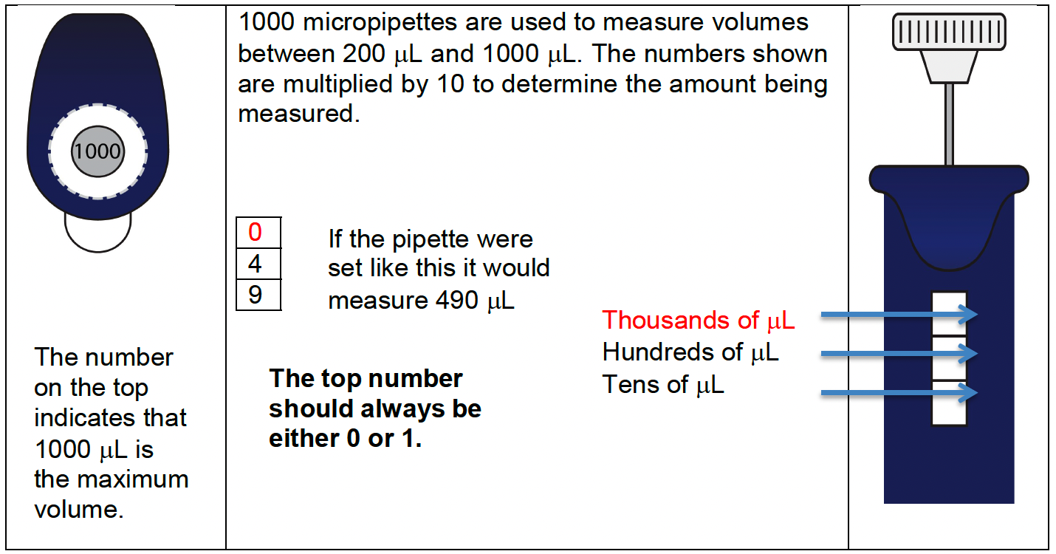
P1000: Reading The Volume
The numbers shown are multiplied by 10 to determine the amount being measured
Used to measure volumes between 200 µL and 1000 µL

Slide 22
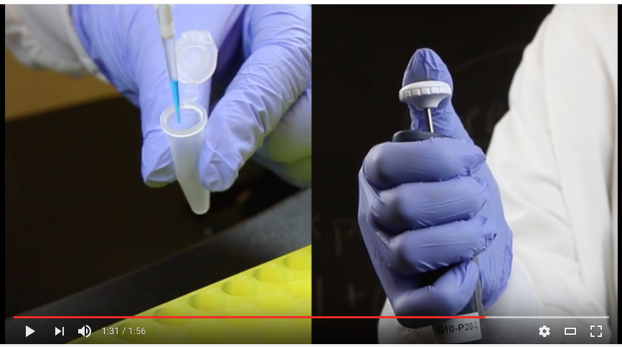
How to Use a Micropipette
Video
Notes:
https://youtu.be/4XlVdyPTQYQ
Video 1
https://www.youtube.com/watch?v=Xvs4eZuj6wA
(lab exchange that goes over how small is microliter

Slide 23
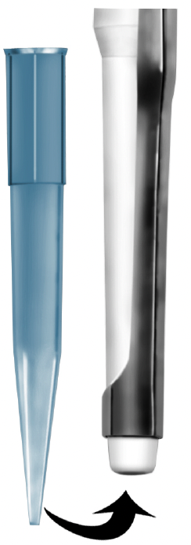
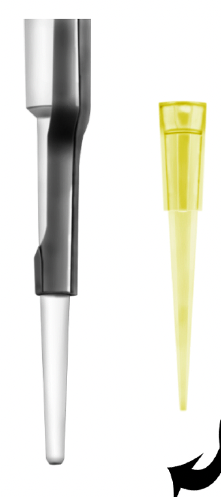
Pipette Tips
Liquids are never drawn directly into the pipette, use a disposable pipette tip
There are two sizes of tips:
  The larger blue tips are used for p1000
  The smaller clear tips are used for the p20 and p200
They are in boxes that are sterile
Please be careful when touching box or tips not to contaminate them
The box should be closed when not in use to prevent airborne contamination
P1000
P20-P200
Notes:
Inserting the Tip
1. Select the correct size tips.
2. Open the box without touching the tips with your hands.
3. Insert the micropipette shaft into the tip and press down firmly. This will attach the tip to the shaft.
4. Remove the micropipettor with the tip attached.
5. Close the box without touching the tips with your hands.

Slide 24
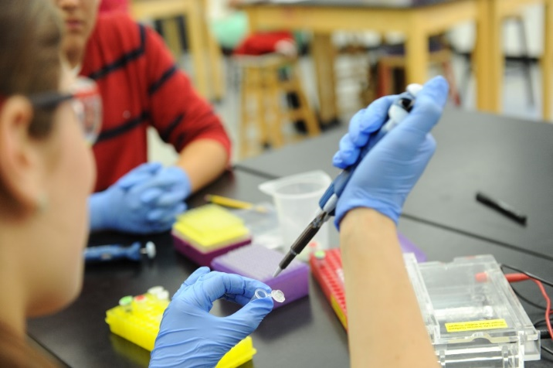
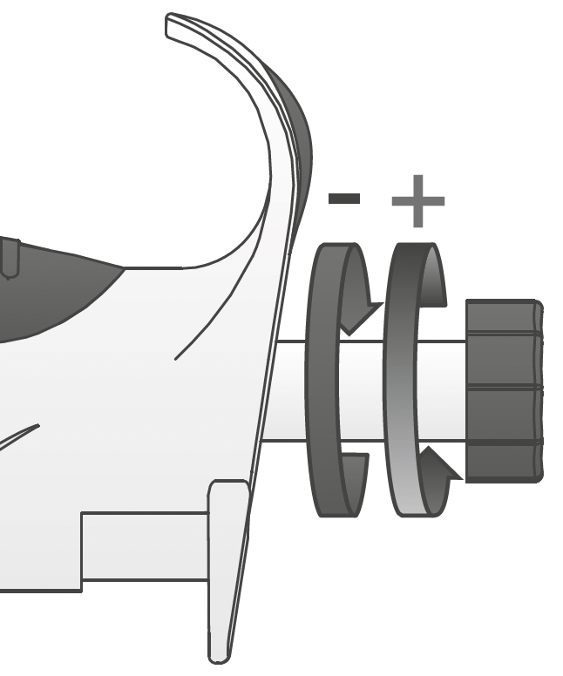
CRITICAL PIPETTING RULES
NEVER…use without a tip in place
NEVER…lay pipette down with sample in the tip
NEVER…let the “plunger” button snap back
NEVER… set the pipette below or above its range.
NEVER…use excessive force to change volume
P200 has a lock, make sure it is in the unlock position before changing volume
To increase volume= Turn the plunger to the LEFT
To decrease volume = Turn the plunger to the RIGHT

Slide 25
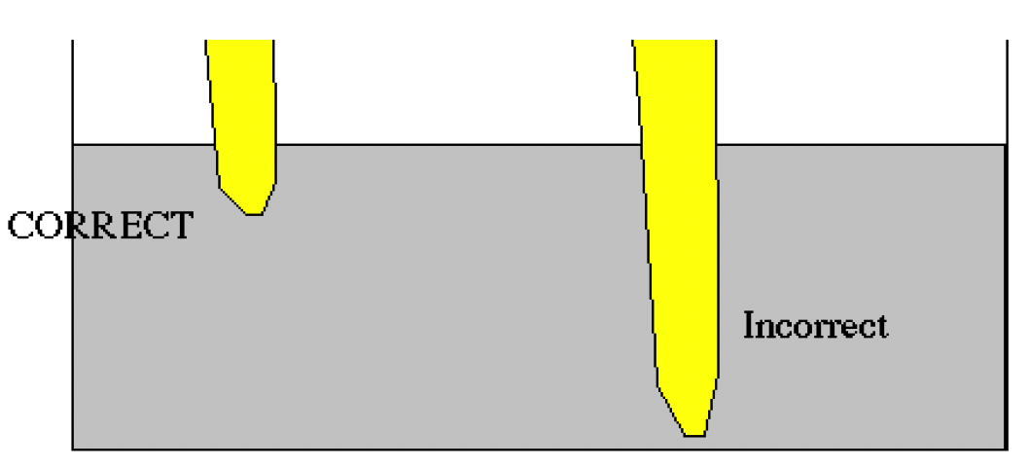
Loading a micropipette
Go Back
  Hold the micropipette in one hand, at a 45° angle from vertical (contaminants from the hand or micropipette don’t fall into the tube)
  Push plunger to first stop
  Lower tip below level of solution
  Slowly release plunger
  Watch solution enter….no air!!
Video 2

Slide 26
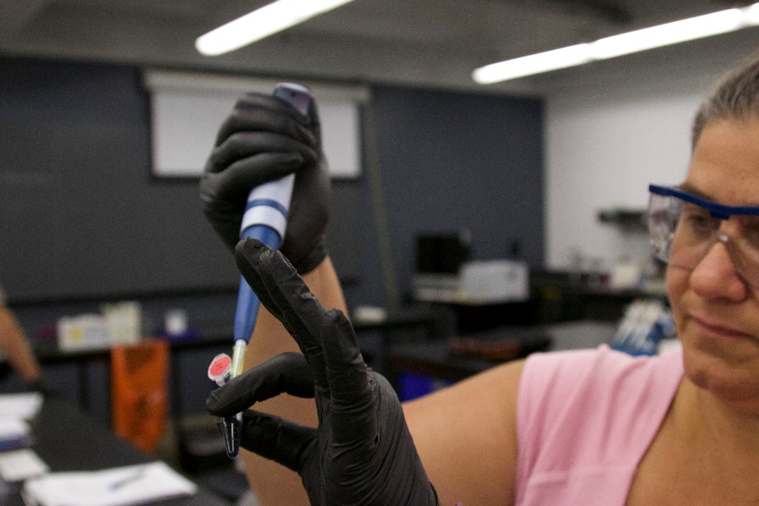
PIPETTING TECHNIQUES
Hold the micropipette and microfuge tubes at eye level when loading or dispensing samples. WHY?

Slide 27
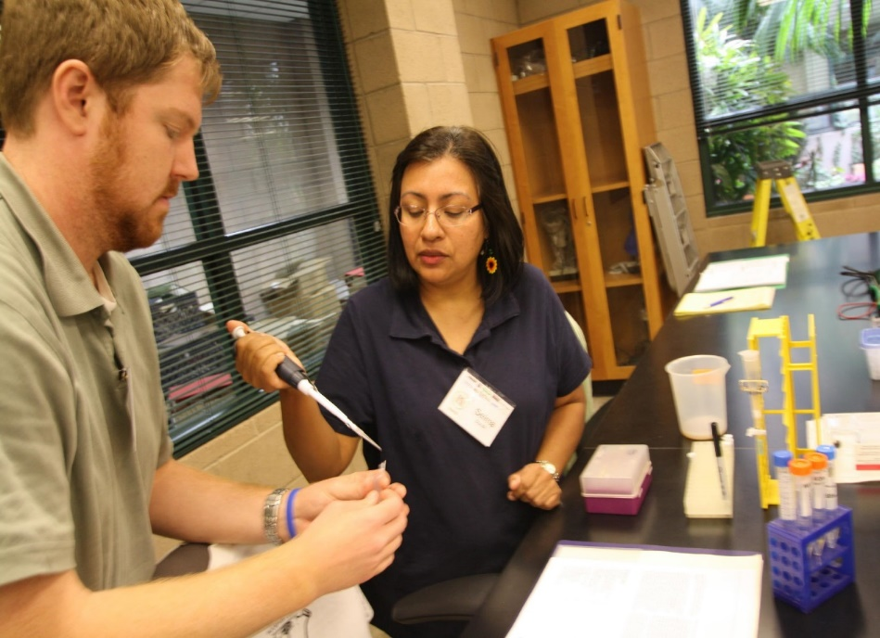
PIPETTING TECHNIQUES CONT.
If you are pipetting, you should be holding the tube.
Common mistake!
NOT the Lab partner!
Notes:
Be sure that the student or teacher pipetting is holding the tube, not the laboratory partner.

Slide 28
Let’s Practice!

Slide 29
Volume Settings: P200 Exercise 1
Set the digital display to the following settings and have it checked by the teacher (have each group member take a turn).
30μl ____ 155μl ____
122μl ___ 50μl____

Slide 30
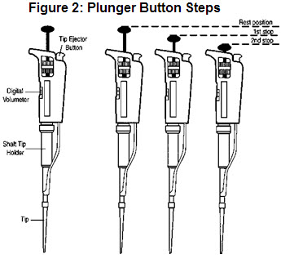
Plunger settings: P200 Exercise 1
Have each group member do the following:
Push the plunger to feel the first stop, then slowly release…this stop is used to take up the sample
Push the plunger all the way down to the second stop, then slowly release … this stop is used to expel the sample
** Be sure to feel the difference between the two stops**
worksheet
Notes:
Hold the micropipet in one hand, at a 45° angle from vertical. In this way, contaminants from
your hands or the micropipet will not fall into the tube.
6. Depress the plunger of the micropipet to the first stop, and hold it in this position.
7. Place tip into the solution to be pipetted.
8. Draw fluid into the tip by slowly releasing the plunger.
How to expel a sample from the micropipet:
9. With your other hand, open the cap or lid of the tube you are filling.
10. Gently touch the micropipet tip to the inside wall of the tube into which you want to expel
the sample. This creates a tiny surface-tension effect that helps draw the fluid out of the tip.
11. Slowly, depress the plunger of the micropipet to the first stop, and then the second stop to
expel the last bit of fluid, and hold the plunger in this position.
12. Slowly, remove the pipet from the tube, keeping the plunger depressed to avoid drawing any
liquid back into the tip.
13. Always change tips for each new reagent you pipet. To eject a tip, depress the ejector button
on the top of the micropipet.
TO SUM UP:
Taking up sample: Down to first stop and hold Into liquid Slowly release
Releasing sample: Down to second stop and hold Lift micropipet out of tube Eject tip

Slide 31
Check for Understanding
When measuring liquids, do you push the plunger to the first or second stop before inserting it into the liquid
First
True or False: your micropipette tip should touch the bottom of the liquid container to get the best measurement
False
True or False: you should remove the tip once you are done by grabbing it with a gloved hand.
False

Slide 32
Check for Understanding
Which micropipette would be appropriate to measure 250μl, P20, P200 or P1000?
P1000

Slide 33
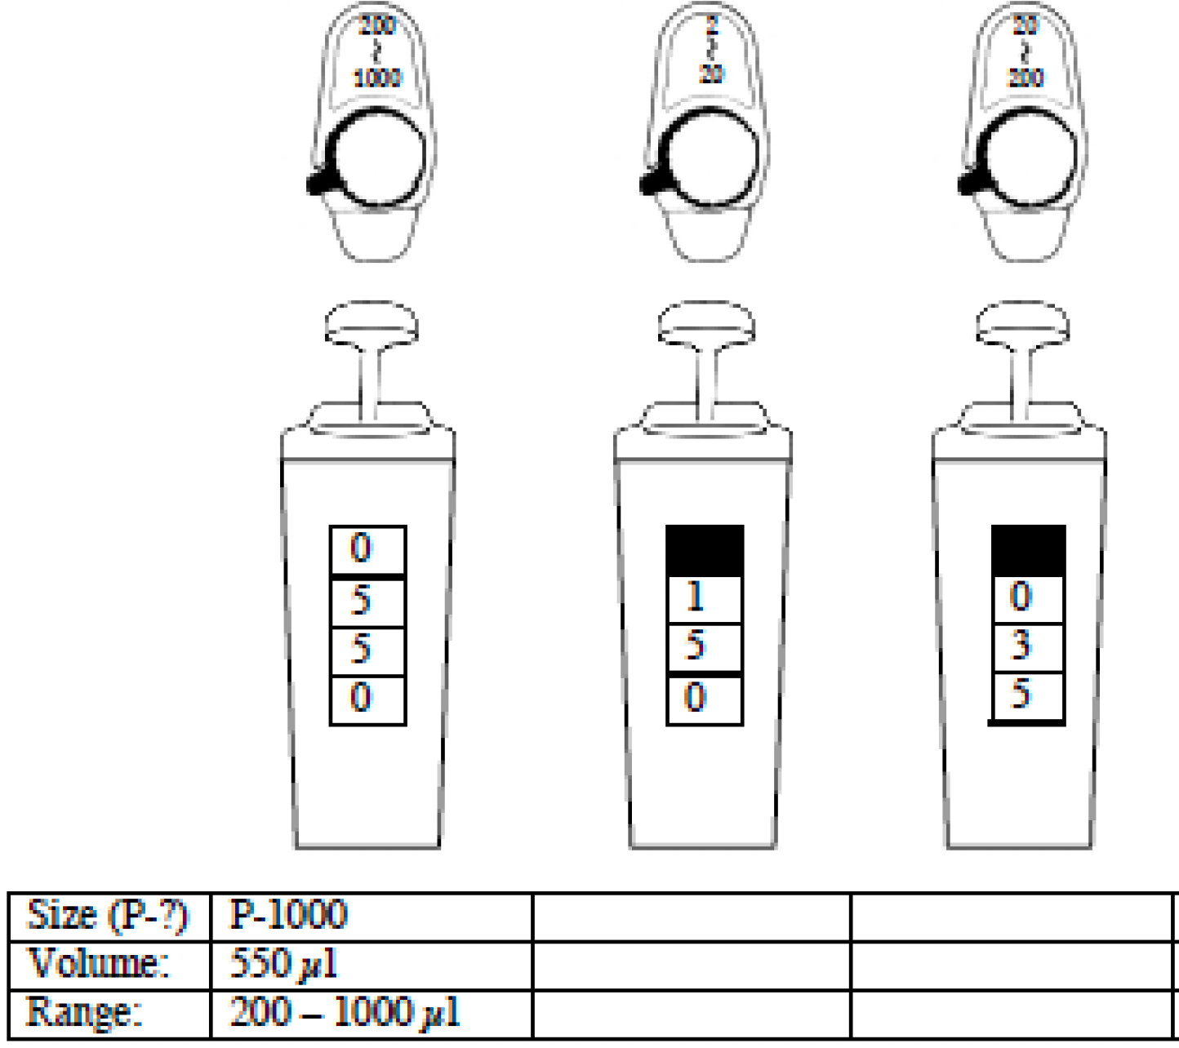
✅ for Understanding
P1000
P20
P200
P20
P1000
P200
P20
P200
15.0 µl
35.0 µl
2 - 20 µl
20 - 200 µl

