Slide 1
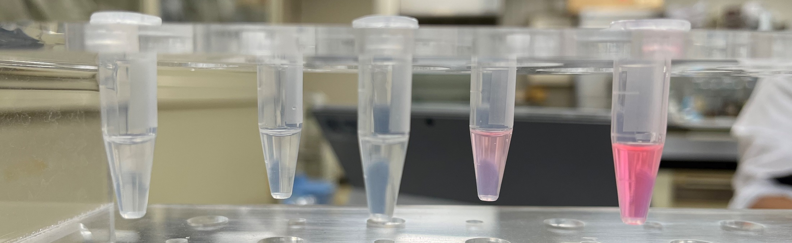
Purified RFP
We do anion exchange chromatography for Lab 6.
NaCl 0 25 50 100 200 mM

Slide 2
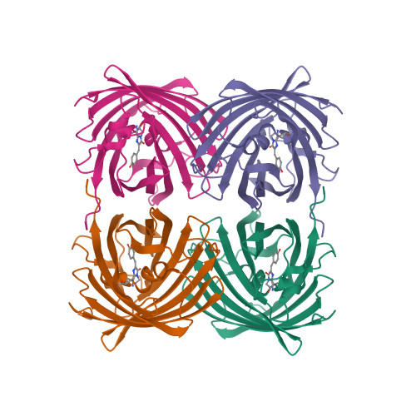
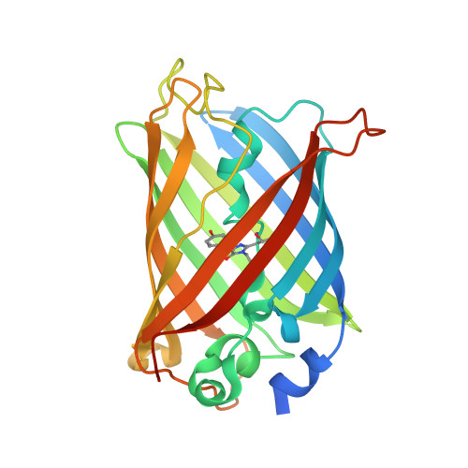
Fluorescent proteins have beautiful shapes
RFP
GFP
If the shapes are changed, what will happen to the fluorescence?

Slide 3
RFP denaturation experiment
Prepare 1.5 mL tubes with 50 μL of purified RFP

Slide 4
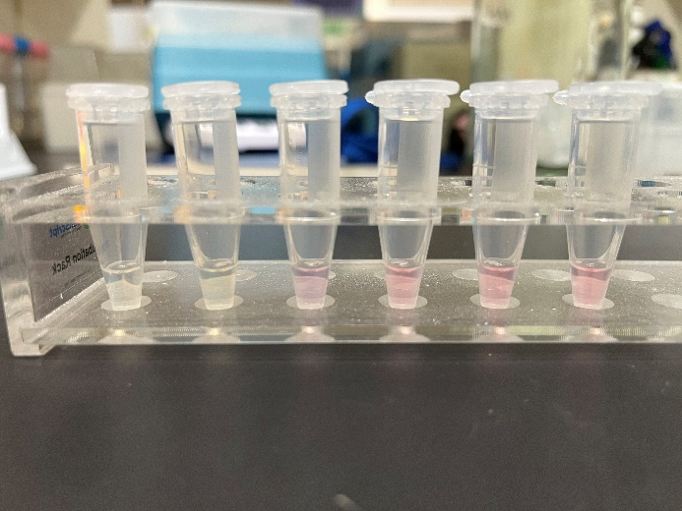
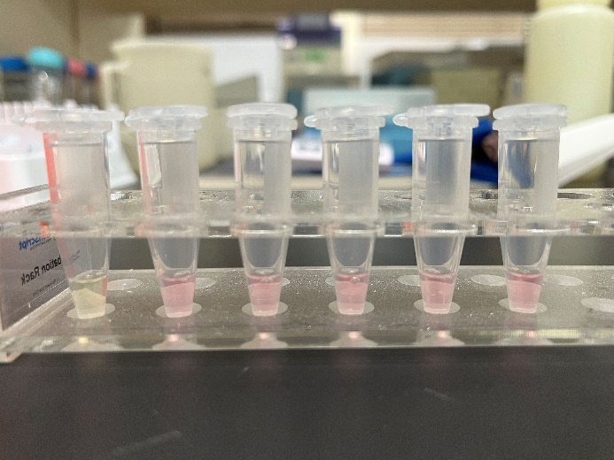
RFP denaturation experiment
Denaturation either by acid or base
  10 mM hydrochloric acid （HCl） 50 μL
  10 mM sodium hydroxide（NaOH） 50 μL
  Distilled water 50 μL
HCl 10⁻¹ 10⁻² 10⁻³ 10⁻⁴ 10⁻⁵ 10⁻⁶ M
NaOH 10⁻¹ 10⁻² 10⁻³ 10⁻⁴ 10⁻⁵ 10⁻⁶ M
denatured
denatured

Slide 5
RFP denaturation experiment
Neutralization (acid + base / base + acid)
  Case A: acid + base
  Add 50 μL of 10 mM HCl
  Then 50 μL of 10 mM NaOH
  Result: Red color fades at step 1, and does not come back even after neutralization at step 2
  Case B: base + acid
  Add 50 μL of 10 mM NaOH
  Then 50 μL of 10 mM HCl
  Result: Red color stays at step 1, and does not fade by addition of HCl at step 2
Sorry, no pictures!

Slide 6
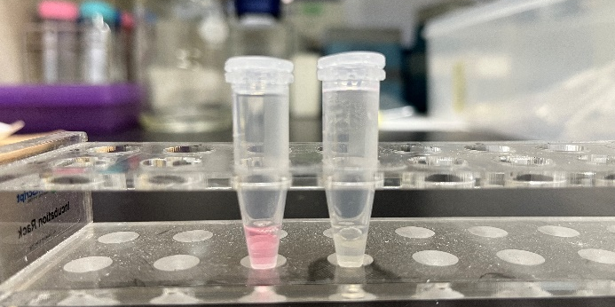
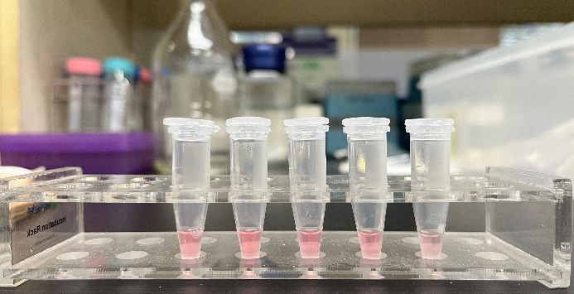
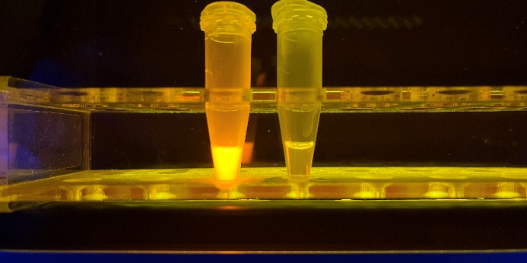
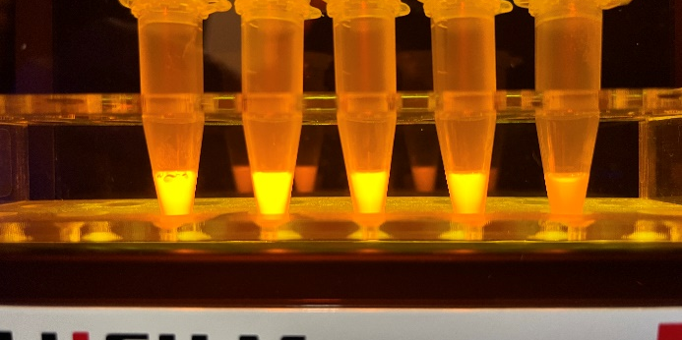
RFP denaturation experiment
Denaturation by heat
  Heat at 100⁰C for 2 min
  Heat at 80⁰C for 2, 5, 10 or 20 min
Let’s talk about boiled egg
(How do temp and time affect?)
Control
Heat
100⁰C
80⁰C
0 2 5 10 20 min
LED
partially denatured
denatured

Slide 7
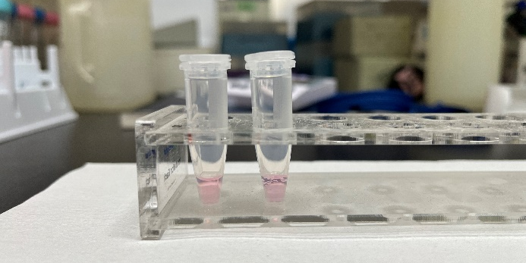
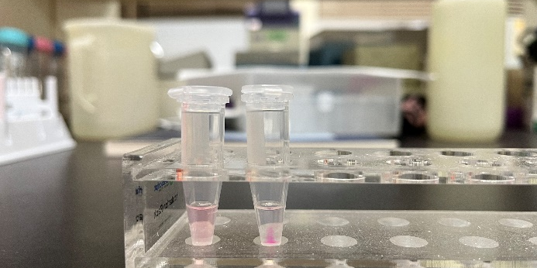
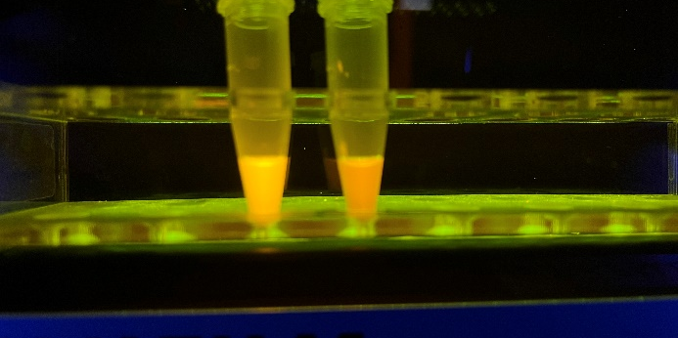
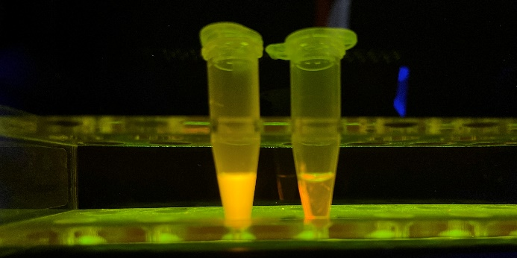
RFP solution vs. suspension experiment
You can do this experiment if you have a centrifuge (10,000 xg, 3 min)
Add reagent
  Distilled water 100 μL
  Saturated ammonium sulfate (NH₄)₂SO₄ 100 μL
Before centrifugation
After centrifugation
1 2
1 2
Difference not apparent
Precipitated but still red

