Slide 1


ABE EXPRESS

Slide 2




CHALLENGES FACED…
Very packed curriculum
Teachers too busy
Not confident to conduct

Slide 3
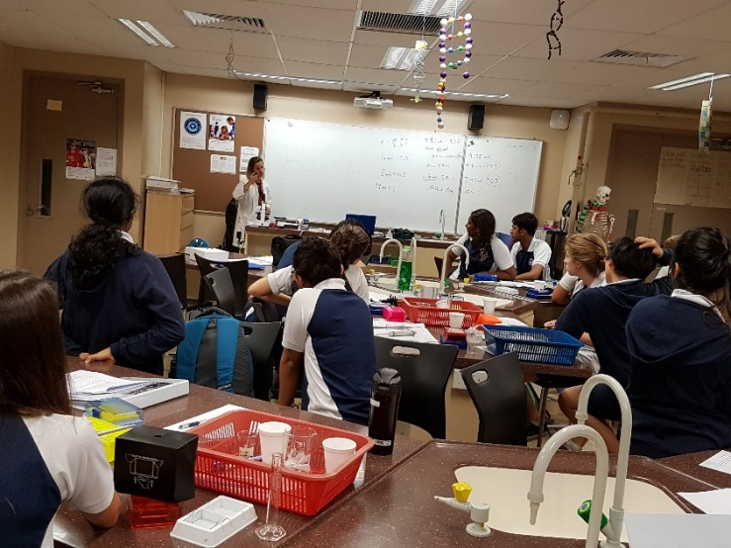
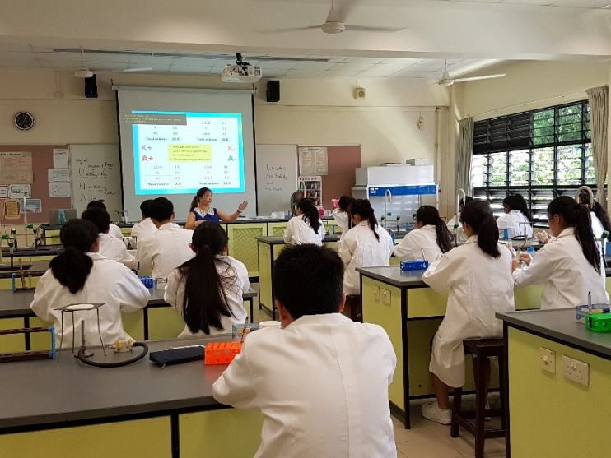
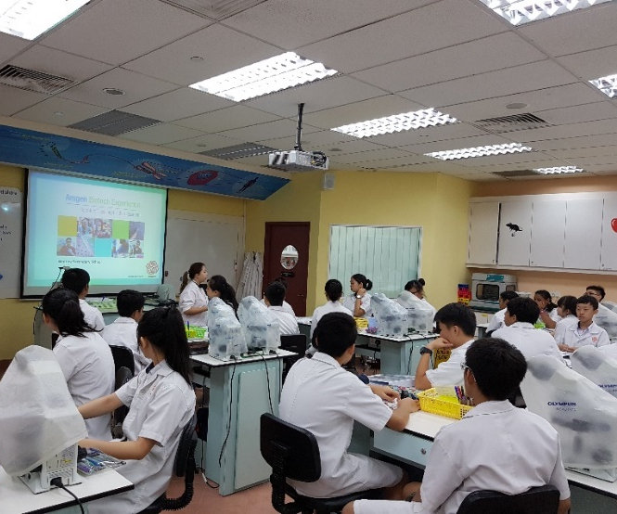
VARIOUS IMPLEMENTATION METHODS
School does the full programme on their own in school
Science Centre educator conducts the programme for the students in the school
Science Centre educator conducts the programme for the students in Science Centre

Slide 4
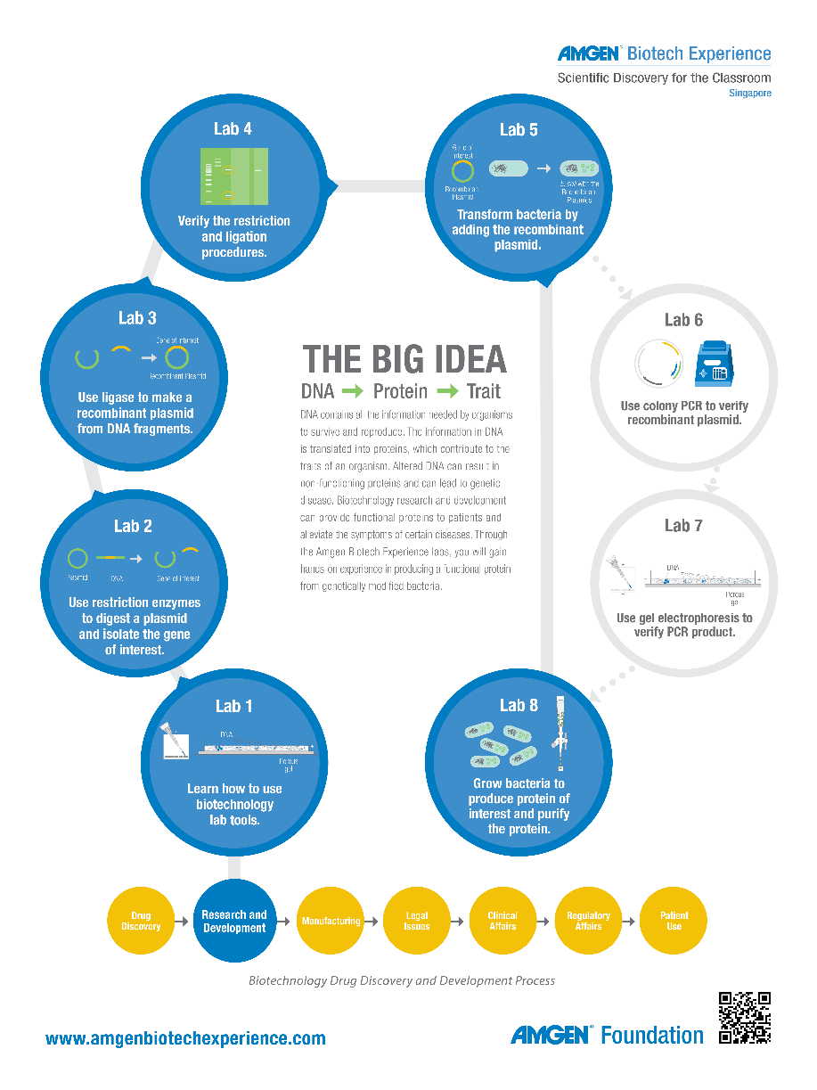
ABE Express
Condensed 1-2 days version conducted by Science Centre educator in Science Centre
  ABE Express Beginner
    1 day, 13-14 year old
    Practical: Lab 1, 4-5. Lab 2-3 done as paper activity
  ABE Express Intermediate
    1.5 days, 15-16 year old
    Labs 1-5,8
  ABE Express Advance
    2 days, 17-18 year old
    Labs 1-8

