Slide 1
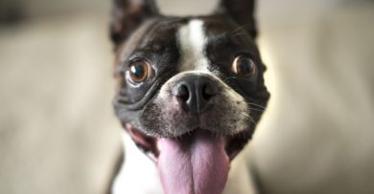
CSI Case:
Which Dog Ate
Jane’s Homework?

Slide 2

THE CASE OF THE HALF-CHEWED HOMEWORK
JANE FINISHED HER BIOLOGY HOMEWORK AND LEFT IT ON HER DESK WHILE SHE WENT TO PARTY SATURDAY NIGHT.
WHEN SHE RETURNED, HER HOMEWORK WAS HALF EATEN AND THERE WAS A BIG PUDDLE OF DROOL ON HER DESK.

Slide 3
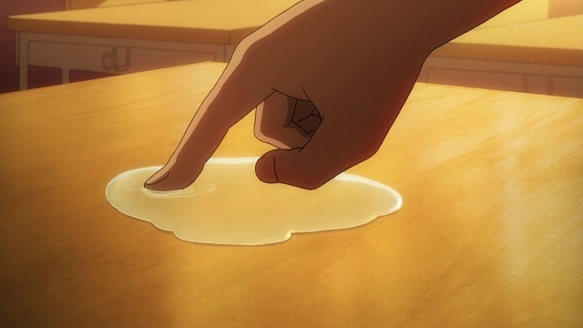
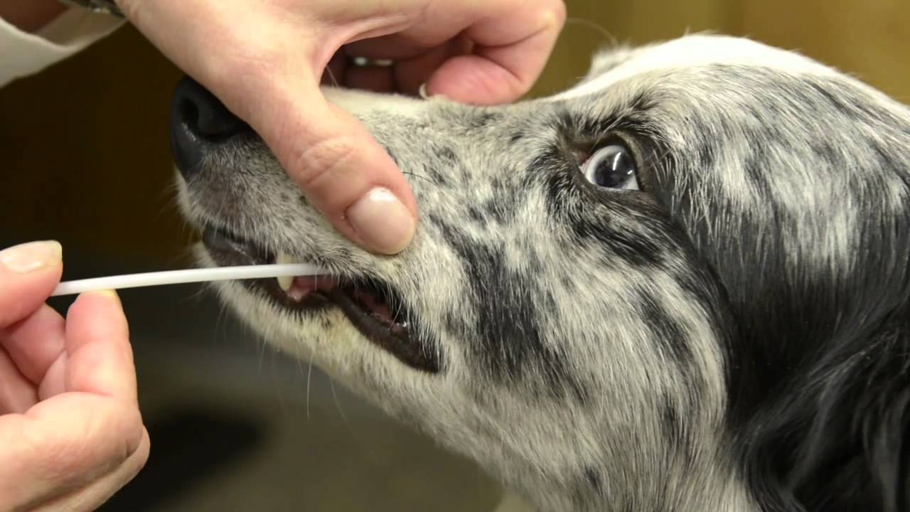
THE CRIME SCENE
THE ONLY ORGANISMS AT HOME THAT EVENING WERE JANE’S TWO DOGS (A AND B) AND TWO VISITING NEIGHBOR DOGS (C AND D).
JANE TOOK A SAMPLE OF THE DROOL ON HER DESK.
SHE THEN SWABBED THE CHEEKS OF EACH OF THE DOGS TO OBTAIN DNA SAMPLES.

Slide 4
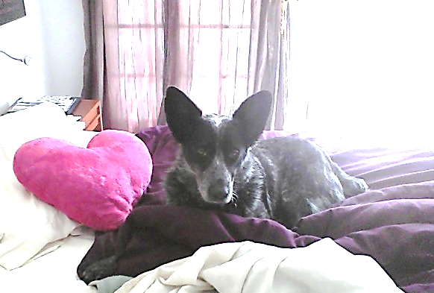
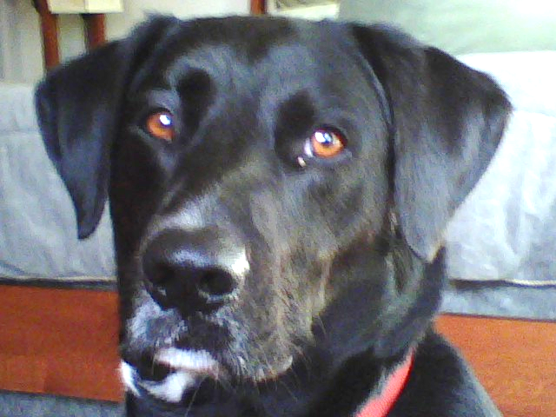
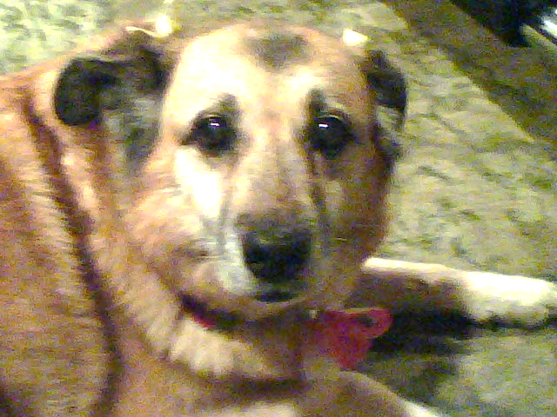
CRIME SCENE : SUSPECTS
C
Zippy
A
Elliot
B
Molly
D
Buddy

Slide 5
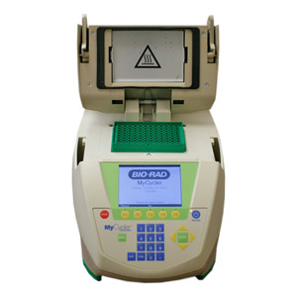
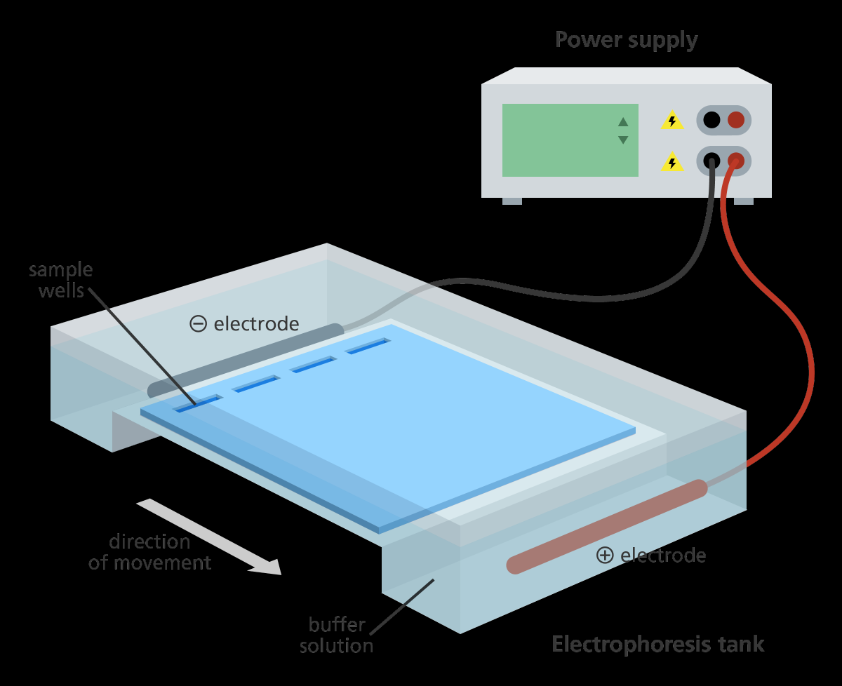
EVIDENCE
JANE AMPLIFIED THE CAREFULLY LABELED DNA SAMPLES USING PCR AND THEN USED RESTRICTION ENZYMES TO CUT THE SAMPLES INTO FRAGMENTS WHICH SHE INTENDS TO RUN ON GEL ELECTROPHORESIS TO IDENTIFY WHICH DOG ATE HER HOMEWORK.
YOU, AS HER FRIEND, OFFERED TO RUN THE GEL ELECTROPHORESIS FOR HER.
5'--GGATCC--3'
3'--CCTAGG--5'

Slide 6
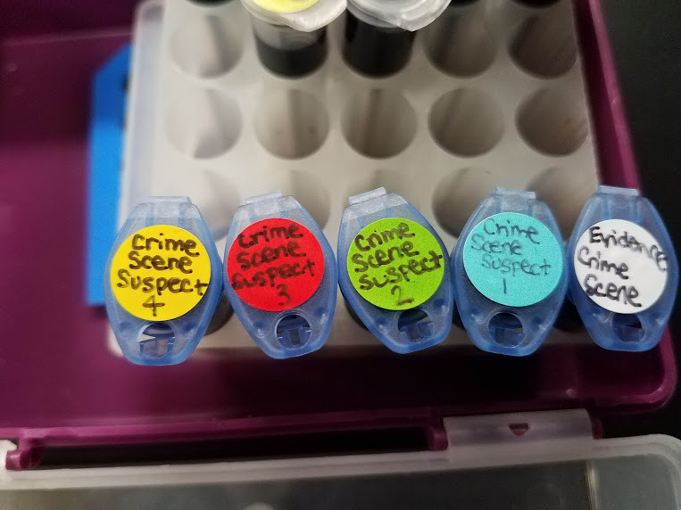

Slide 7

SO WHAT HAPPENED?

Slide 8

WHAT IS YOUR CONCLUSION?
Be sure that you can cite
evidence to support your conclusion!

